Slide 1
Town of Jamestown
FY2020-2021
Town Administrator
Proposed Operating Budget
March 9, 2020

Slide 2
    Operating Budget Work Session #1
Monday, March 9, 2020
  Town Council (pg. 1) Public Works (pg. 17-19)
  Town Administrator (pg. 2) Administration, Engineering, Highway Legal Counsel (pg. 5) Snow Plowing, Street Lighting, Other Public
  Personnel (pg. 9) Works, Public Buildings, Tree Management
  Finance Department ( pg. 10) Library (pg. 22)
  Audit (pg. 12) Recreation (pg. 23) Information Technology pg. 13) Debt Service (pg. 24) Zoning/Building Official (pg. 8 & pg. 16)
  Page#’s are for Town Council reference

Slide 4
PROPERTY TAX PROGRAM
To support the 2020-2021 fiscal year appropriation, a property tax rate of $8.20 per thousand dollars of assessed valuation will be necessary. This includes a rate increase of .15 cents from the 2020 fiscal year rate of $8.05. The distribution of the rate for Municipal Operations will require an increase from $3.27 in FY 2020 to the revised rate of $3.39 in FY2021 or an increase of $.12 or 3.65%. The School Department will realize a rate increase from $4.78 in FY 2020 to $4.81 in FY 2021, an increase of $.03 or .58%

Slide 5
TAX LEVY
The balance of the revenues necessary to support the Towns $26 million budget is derived from the local property and motor vehicle taxes. As reflected in the below spreadsheet, a tax levy of $21,289,708 is proposed for the 2020-2021 fiscal year.
Under the 4% cap requirement, the maximum tax levy increase the Town could have sought under the existing limit, totaled $21,727,917 or an increase of $835,689. The proposed budget reflects an increase of $726,143, or a 3.48% increase and $109,546 below the 4% cap limit.

Slide 6
TAX RATE HISTORY
The tax liability for the average residentially assessed property in the value amounts indicated, reflect an increase based on the proposed $.15 tax rate increase. These figures reflect an increase based on a given property’s assessment not having changed from the prior year.

Slide 7
Property Tax Impact
Static evaluation of tax rate impact from statistical revaluation on a set series of property values, based on actual and projected rates over a period of several years.

Slide 8
CAPITAL PROGRAM
In FY 2020-2021, the Municipal Capital Program is proposed at $834,233, reflecting an increase of $22,313 or 2.75% from the current fiscal year adopted budget of $811,920. For FY 2020-2021 a program is offered to address existing needs within the community and a few set-asides for upcoming projects.

Slide 9
FUND BALANCE
This Unrestricted Fund Balance reserve should amount to no less than two months of regular general fund operating revenues or general fund operating expenditures of 16.67%. At the end of the FY 2018-2019, the audited general fund unassigned fund balance was $5,377,954 which equaled 21.53% of the total Town & School FY2020 budget.

Slide 10
FY 2020-2021 Revenue Program

Slide 11
Town and General Revenues remain static with the exception of a slight increase in State Reimbursement for motor vehicles.

Slide 12
State Aid to the Town has been increased by $20,236 although when combined with State Aid to education, the total reduction equals ($25,468) as proposed for FY2020-2021.

Slide 13
FY2020-2021 Expenditure Program

Slide 14
Proposed Overview General Fund Operating Budget FY2020-2021

Slide 15
Proposed Overview General Fund Operating Budget FY2020-2021

Slide 16
Town Council:
  Administration has not proposed any changes for FY2021

Slide 17
Town Administrator: Decrease due to personnel change, increase due to contractual obligation

Slide 18
Legal Services: Administration has not proposed any changes for FY2021

Slide 19
Personnel: Line items have been adjusted to anticipated expenses, rates and enrollments

Slide 20
Finance: Reflects contractual obligation, salary increase and increase in cost of supplies

Slide 21
Audit of Accounts: Increase recommended due to Audit being bid out and increase in reporting
requirements with the State

Slide 23
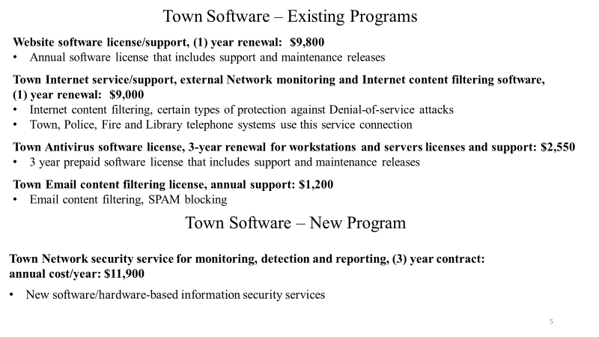

Slide 24
Zoning/Protective Service: Zoning decrease reflects spending trend and Protective Service increase reflects
contractual and salary/longevity increase

Slide 25
Administration: Increase reflects salary/longevity increase
Engineering: Increase reflects salary/longevity increase

Slide 26
Highway: Increase reflects salary/contractual obligation
Salary OT - reflects decrease due to trends
Vehicle Insurance - reflects rate adjustment
Upkeep of Equipment/Sand & Gravel – reflects cost increase

Slide 27
Waste Removal: Increase reflects contractual obligation, telephone, electricity costs and trash/recycling removal
Street Lighting: Slight decrease reflects cost savings with new whole-seller rates

Slide 28
Other Public Works: Increase for Community Band
Public Buildings: Decrease reflects cleaning contract trends and electricity savings.

Slide 29
Library: Increase for salaries, insurance, information technology & books. State Aid is provided by the State with the amount off-set in State Aid revenue.

Slide 30
Parks, Beaches & Recreation: Increase for salaries/longevity and the re-organization of the laborer/seasonal positions. Other increases/decrease reflect trends.

Slide 34
Bonds approved not issued

Slide 35
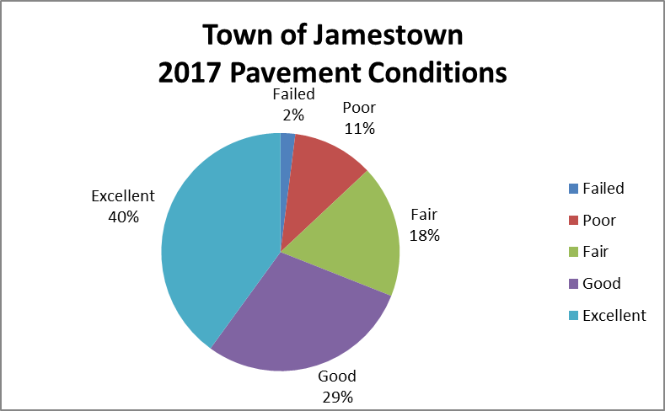
Pavement Management-
Current efforts to improve the pavement conditions in the Town have been effective in that the inventory of roadway surfaces in the good and excellent categories has increased. The 2017 graph does not include North Road improvements and other streets selected for 2019-2020.
2017 Road Conditions

Slide 36
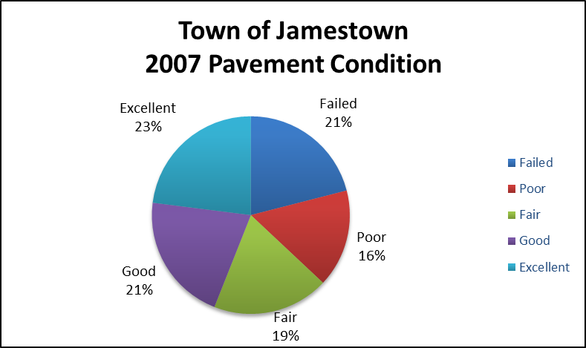
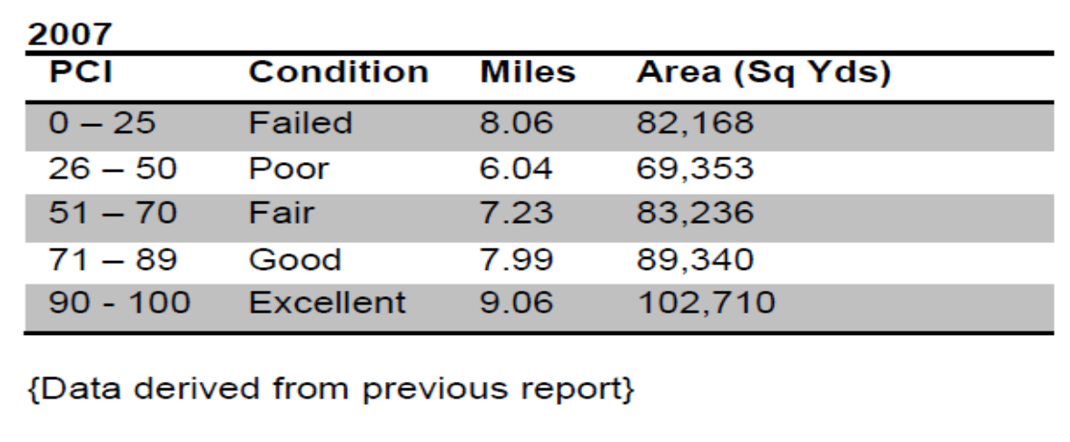
2007 Road Conditions

Slide 37
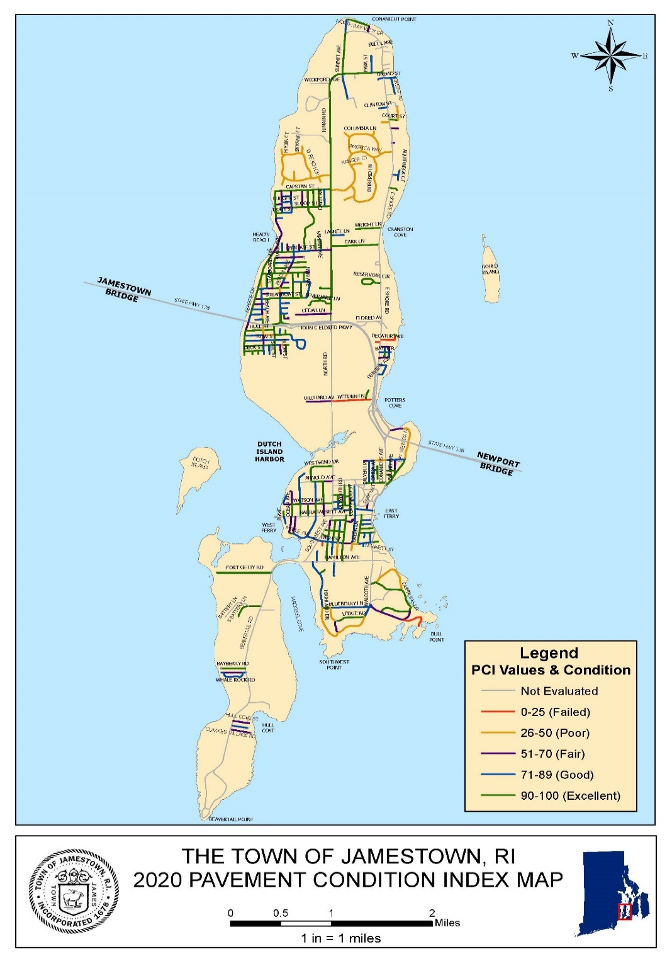

Slide 38
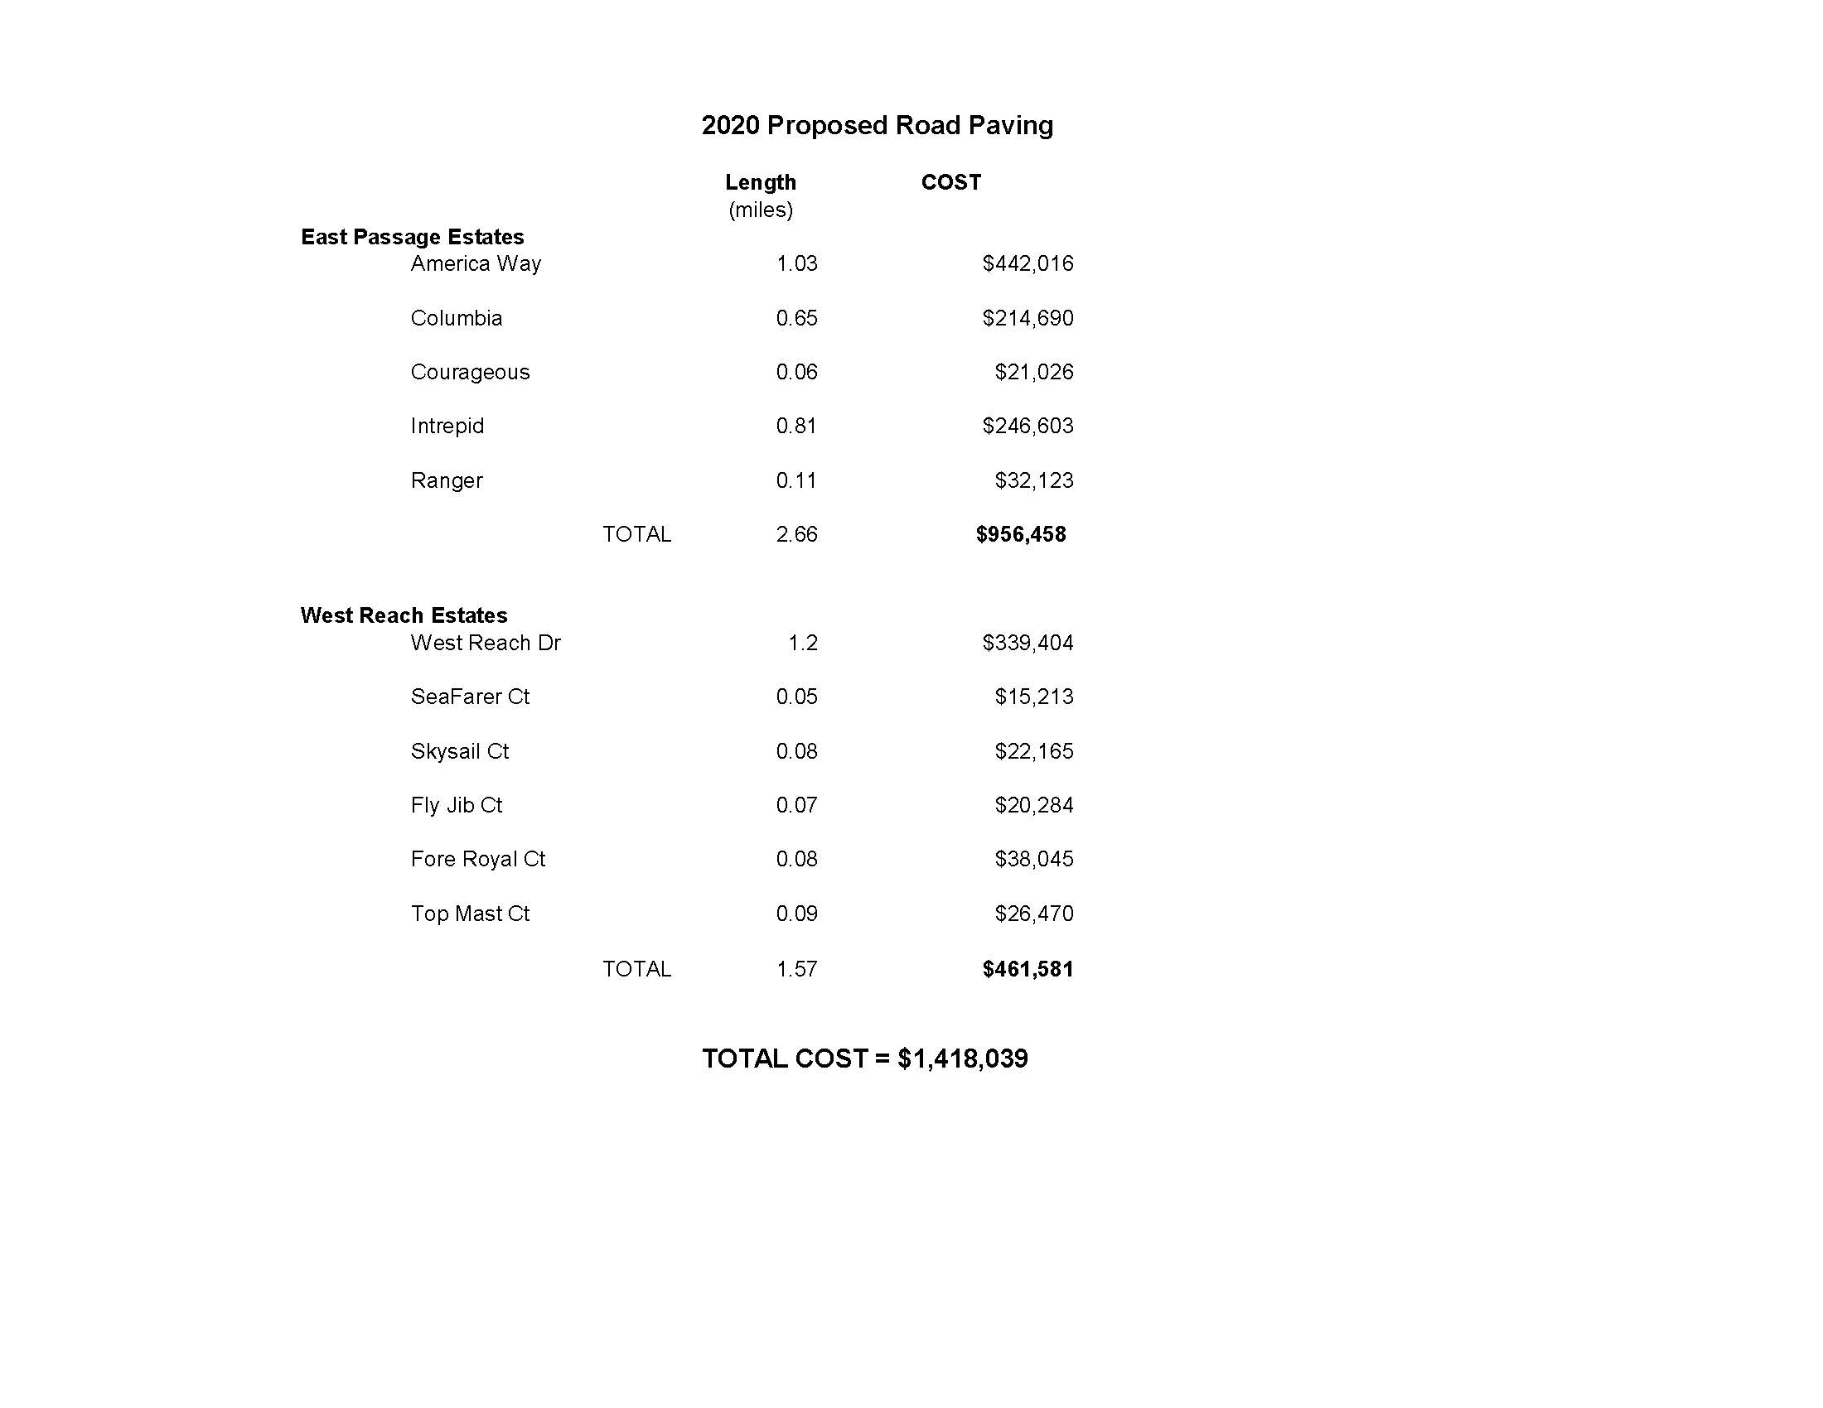

Slide 39
Anticipated Debt for Road Paving- pending approval

Slide 40
Anticipated debt for Library project – pending approval

Slide 41
FINAL SLIDE
Operating Budget Work Session #1

Slide 42
OPERATING BUDGET PRESENTATION
SESSION #2
March 10, 2020

Slide 43
Operating Budget Work Session #2
Tuesday, March 10, 2020
Probate Clerk (pg. 3)
Election & Town Meetings (pg. 4)
Clerk & Records (pg. 6)
Planning (pg. 7)
Tax Assessor (pg. 11)
Police Protection/EMA (pg. 14)
Fire Protection (pg. 15)
Senior Services (pg. 21)

Slide 44
Probate Court: Salary increase and decrease due to spending trends

Slide 45
Election & Town Meetings: Increase for the additional elections occurring in FY21

Slide 46
Clerk & Records: Decrease to reflect personnel change and re-allocation for Election meetings, slight increase
in Fees, Supplies & Dues to reflect trending

Slide 47
Planning: Salary increase and increase in acct#302 to reflect funding loss from CDBG

Slide 48
Tax Assessor: Salary increase and decrease in acct#302

Slide 50
Police Protection –
Salary/longevity for Police Chief & Dispatchers have been increased to reflect contractual obligation
Overtime for Dispatch reflects trends since separating from Police OT
Salary/longevity/Benefits for Police Officers have been level funded, increase is steps for 4 officers
Police Retirement decease for Actually Determined Contribution (ADC) provided by Angell Pension
Computer software increase to reflect reallocation from other lines to have all software in one account
Vehicle Insurance increase for premium adjustment
Telephone slight increase to reflect cost
Ammunition & Supplies increase for cost and additional firearms proficiency
Training increase reflects the number of training sessions to be conducted
Equipment increase for computer upgrades

Slide 52
Fire Protection-
Salary/benefit increase consistent with others
FICA reflects actual cost
Stipend Deputy Fire Chief (2), has not increased since inception
Fire Inspector paid hourly increase is consistent with others (will make minor adj)
Incentive Retired Members to reflect actual cost
Equipment/Safety Maintenance paid hourly increase is consistent with others
Fees, Supplies, Dues increase for payroll services
Vehicle Insurance reflects premium increase
Apparatus & Truck repair increase reflects cost associated with aging fleet

Slide 53
Senior Center Operations – Salary increase, Advertising increase to promote programs previously paid in Recreation, Premium adjustment for Insurance on the building, decrease/increase in utilities reflect trends

Slide 54
END - Operating Work Session #2

