Slide 1
Prospective Cell Tower Site to Service North End of Jamestown
M. Glier
J. Lambert
A. Wengefeld
A. Giroux
8/20/2018

Slide 2
Why are we discussing this initiative?
Cellular Service on North End ranges from poor to nonexistent
Police and Fire communications continue to experience poor performance
Town owns parcels on the North End that may be suitable for a cell site
We have experience with leasing to cellular carriers
Market opportunity for carriers
Survey data suggests new site could service more users than currently served by Howland Avenue site

Slide 3
Increasingly Important Issues
More households are disconnecting from landline-based services
Communications become very dependent on cell services
Need for reliable public safety- police and fire communications
Wireless has become preferred service delivery method

Slide 4
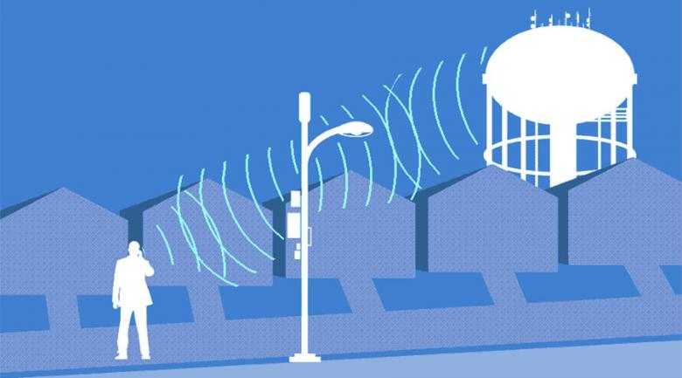
Goals of Initial Effort
Identify at least 2 parcels that may be prospective cell sites
Estimate the number of North End parcels that may be served by each site
Show basic criteria used for preliminary site selection/rejection

Slide 5
Overview of Terms
“Parcel”
Properties from existing Town Platt maps
Not Town-owned property or covenant restricted
May/may not have existing dwellings
“Primary Service Area”
Parcels within a 1.62 miles radius circle around the proposed site
Term sometimes used for area of “Good service indoors”
“Secondary Service Area”
Parcels between the 1.62 mile radius and a 2.0 mile radius circle around the proposed site
Term sometimes used for area of “Minimum service indoors” and “Good service outdoors”

Slide 6
Criteria for Location, by Priority
Locations that we believe could serve the largest number of North End parcels
Parcel height above sea level
Higher elevation reduces required tower height to achieve best signal levels across delivery
Minimum parcel size to accommodate 3 carriers
22K/24K SF (~ ½ acre)
Access and minimum distance to utilities, with fiber communications service being the most important
Accessibility of site during and after extreme storm conditions

Slide 7
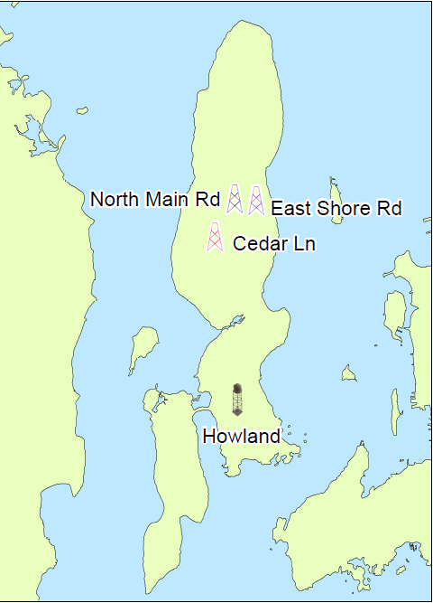
Initial Survey Results
Determined that 3 Town-owned parcels met base use criteria (in order of priority with general location noted)
Top of Cedar Lane
North Pond, adjacent to the North Road drainage capture basin, currently under construction
East Shore Road, adjacent to North Pond

Slide 8
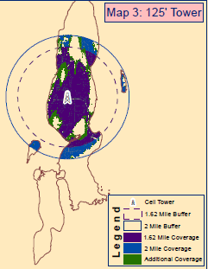
Cedar Lane Survey Area

Slide 9
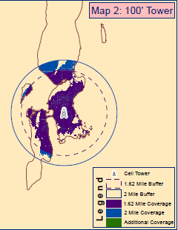
Howland Ave Survey Area

Slide 10
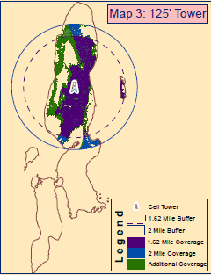
North Main Road Survey Area

Slide 11
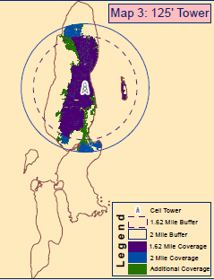
East Shore Road Survey Area

Slide 12
Site Survey Parcel Coverage Comparisons
Parcels covered using 2 Mile Radius, 125 ft. Tower
Site | Parcels
Cedar Lane | 1775
Howland Avenue (100ft) | 1434
North Main Road | 1215
East Shore Road | 598

Slide 13
Decision on Next Steps
Town Council direction required before proceeding
Next steps to include:
More formal internal discussions between Administration, Planning, Zoning, and Public Works
Preliminary site reviews: Soil sampling, draft site plan, other work to confirm/reject site suitability
Determine RFI or RFP development to bid outside engineering firm services

