Slide 1
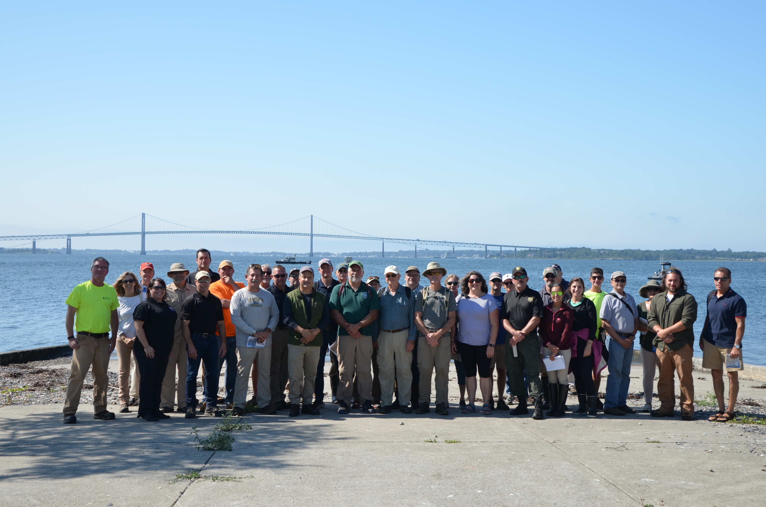
Gould Island
Jamestown Town Council, Sept 16, 2019

Slide 2
Gould Island South RAB Status
Army Corps 2 Years Into Restoring South Gould
  Formerly Used Defense Site (FUDS)
  Under 1980 CERCLA legislation (Superfund)
    Chemical contamination cleanup only
  One time Federal presence for cleaning up Gould
  Sampling & analysis plus minimal debris removal only
Issues Identified So Far
  Contaminant cleanup plan was initially only for birds
    Now for public recreation (RIDEM change)
  Groundwater potability cleanup not agreed
  Physical cleanup limited to that incidental to chemical cleanup plus 4 additional structures
  3 Navy owned sites still excluded
Notes:
Here to brief Town on status and plans for Gould Island Restoration
No USACE investigation results to date
Important discoveries about limits of cleanup
Army Corps of Engineers “restoring” South Gould
Formerly Used Defense Site (FUDS)
Under 1980 CERCLA Federal legislation (Superfund)
One time Federal funding for cleaning up Gould
Once done, any further cleanup is RIDEM responsibility
That means any cleanup that the Town wants and that USACE does not do will require state funding
Restoration likely to take years
Community RAB formed by USACE
RAB only to advise USACE on FUDS project
29 members, Town Planner, RIDEM, Save The Bay
First meeting August 7, 2018, Town Council Chamber
Initial survey performed – Winter 2017-18
Preliminary results to be presented to RAB Aug 7
Excluded sites identified (not RAB issue – RIDEM issue)
Level of cleanup depends on planned future use
USACE Future Use Presumption – No human access (not RAB issue)
RIDEM/Town determine

Slide 3
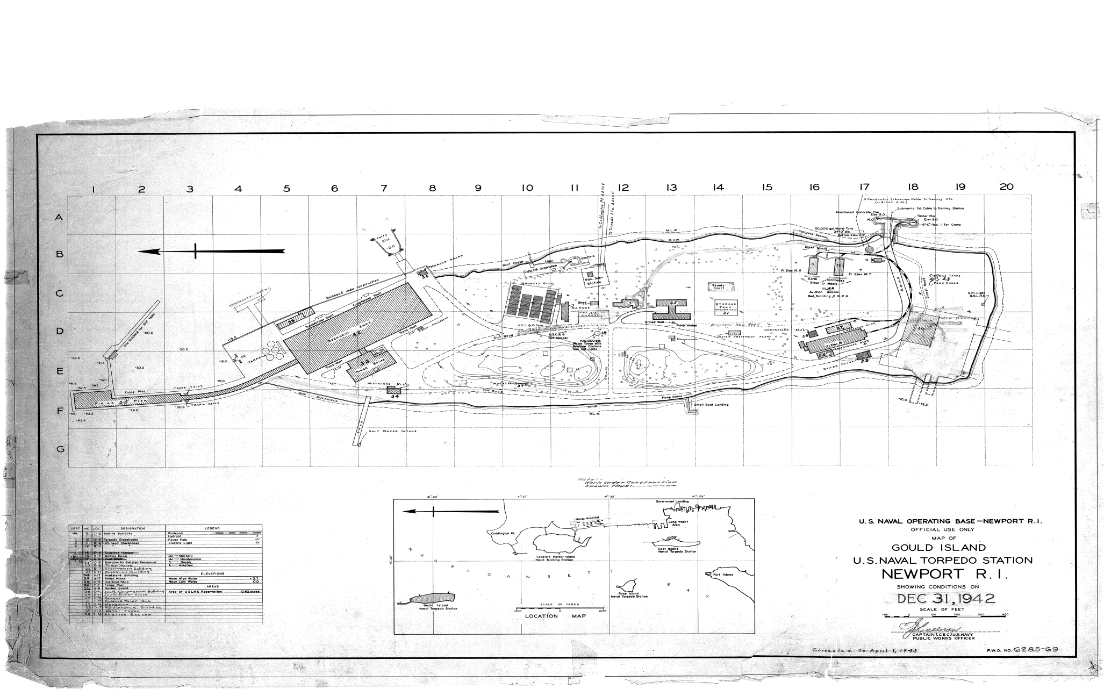
1942 Navy Site Map
Notes:
North is to the left, south is right
Red line is boundary between RIDEM portion of South Gould & Navy owned portion of North Gould
Blue ovals are Navy owned sites on South Gould – were probably fresh water infrastructure
Green oval is Coast Guard owned site

Slide 4
Level of Cleanup
Environmental Cleanup
  RIDEM declaration Sept 2018
    Cleanup for public recreation as well as wildlife
  USACE accepted
Physical Cleanup
  USACE view
    Incidental to chemical cleanup
    Structures unsafe at transfer (3 of ~25 buildings, no debris)
  RIDEM responsible for all other removal
  RIDEM request for USACE to do all physical cleanup
    USACE says not without additional Congressional authority
Notes:
Depends on planned future use
Zoning
Owner’s intention (RIDEM)
USACE presumption wildlife sanctuary only, no human access
Implies lighter cleanup
No building/other debris safety hazard removal
RIDEM policy
No access during bird nesting season April-August
Human access not prohibited September – MarchRIDEM Access Policy
Human access prohibited during bird nesting season
September – March: Human access not prohibited
Now RIDEM to close Island “permanently” – too hazardous
USACE will expand physical cleanup level if Congress authorizes
Need alignment of future use plans: RIDEM, Town
USACE will reconsider cleanup level if RIDEM requests
Needs to be done now
Andy will speak to Town/RIDEM alignment

Slide 5
Physical Cleanup Background
Federal Government took Gould in 1920
  War fighting for benefit of nation
  Navy left South Gould a mess in 1950s
Transferred S. Gould to State/RIDEM in 70s-80s
  RIDEM initially declared wildlife sanctuary
    Did no cleanup
  Now proposed as part of Bay Islands Park System
Town/State cannot afford/may never cleanup
Only Federal Government can make Gould safe

Slide 6
August 15 Site Visit
RAB Initiated / USACE Enabled / Volunteer Supported
  Made possible by Richard DeSalvo, RI Mooring Services
36 Attendees
  14 RAB, 3 Town, 6 DEM, 4 Army, 5 Press, 3 Fed, 1 State
3 Press articles: ProJo, JTN Press, NPT This Week
Follow up on physical cleanup
  Conversations with Jack Reed, Whitehouse/Ciccilline staff
  Commitment from RIDEM to “needs assessment”

Slide 7
Choices
Do nothing more than chemical cleanup
  Island will revert to overgrown habitat
Follow RIDEM direction for Bay Islands Park
  Walking trails & overnight campsites
  Needs extensive physical cleanup for safety
  Now is the time while USACE is on site
  Requires federal funding and direction to USACE
June 2018 Council supported full cleanup

Slide 8
Path Forward
Confirm Town position supporting RIDEM objective and request for full clean up
Town engagement with federal delegation
  Reed office press statement:
    “Before additional funds are secured, local and state partners need to coalesce around a plan and shared commitment, and Senator Reed will work to ensure the federal government and the U.S. Department of Defense are kept in the loop.”
Requires RIDEM long term plan
  Agreed to by Town
  To be implemented after full cleanup (10+years)

Slide 9
Next Steps
Town Council resolution
  Support for RIDEM cleanup objective
  Request RIDEM long term plan
  Ask Town Administrator to:
    Develop Town Plan in coordination with RIDEM
    Request support from federal delegation for full physical cleanup
To be approved at October 7th Council meeting

Slide 10
History of Gould Property Transfers
39 acres transferred from Fed Government to RI
  South 2/3 of Gould
  Deed restriction for conservation of wildlife
  RIDEM is “owner” for State
4 South Gould parcels excluded from transfer
North 17 acres held by Navy for NUWC
  Cleanup on-going for 20 years
  Demolition of pier building planned
Notes:
39 acres transferred from Fed Government to RI
South 2/3 of Gould
3 deeds of transfer: 1975, 1976, 1989
Deed restriction for conservation of wildlife
RIDEM is “owner” for State
4 South Gould parcels excluded
100’x100’ Coast Guard South Beacon area
Building 25A (transformer vault)
Building 31 (underground 500,000 gallon water tank)
Building 42 (water treatment plant)
North 17 acres held by Navy for NUWC
Cleanup on-going for 20 years – RAB in place for all that time
Demolition, re-construction of pier building planned

Slide 11
4 Excluded Parcels
Still owned by Federal Government for Navy/CG
  3 Navy sites now abandoned
  CG navigation beacon on south tip in use
Excluded parcels not part of FUDS
  Not restorable by USACE
  Contamination not being sampled
Navy willing to transfer 3 sites to RIDEM w/o cleanup
CG plans to retain south beacon w/o cleanup
Need RIDEM engagement
Notes:
Still owned by Federal Government for Navy/CG
3 Navy sites now abandoned and past useful life
CG navigation beacon on south tip in use & to remain
Excluded parcels not part of FUDS
Not restorable by USACE
Contamination status not sampled - USACE may be able to estimate
Navy willing to transfer 3 sites to RIDEM w/o cleanup CG plans to retain south beacon w/o cleanup
Need RIDEM engagement with Town advice – Andy had meeting last Friday he will speak to

