Slide 1
Capital Improvement Program
Town Council Work Session
Town of Jamestown
March 19, 2019

Slide 4
Why Develop a Capital Improvement Program?
The primary focus of a Capital Program is to provide a broad-based community needs assessment;
A second important element is the development of an implementation schedule that addresses the community needs assessment priorities; and
The final action is to evaluate the Town’s financial ability to manage and finance the costs associated with addressing the community’s priority needs.

Slide 5
Capital Projects
A Capital Program is a short to mid-range plan that identifies projects and equipment purchases, provides a planning schedule that includes all facilities and infrastructure for all municipal and school facilities including, public safety facilities, water and sewer systems, parks, schools, water and wastewater treatment, and other municipal assets. The plan provides a link to the Town department’s, comprehensive and strategic plans and the annual Town and School budget programs.
A capital improvement or capital project is a large-scale non-recurring tangible fixed asset with a useful life of at least five years and a combined value in excess of $10,000.

Slide 6
CIP Program Trending

Slide 7
CIP Program Summary

Slide 8


Slide 9
Computation of Legal Debt Service Margin
Equals $8,350,200 or 12.2% of recommended debt limit of $68.5 million capacity
Bond Rating Aa1 by Moody’s and Fitch Rating Services

Slide 11
DEBT RETIREMENT SCHEDULE

Slide 12
General Government
FY2019-2020
Town Hall Renovations and Upkeep : $25,000
(Carpeting, Painting, Stairwells)

Slide 13
Town Clerk
FY2019-2020
Clerk Records Management: $2,500
Codification: $5,000

Slide 14
Town Clerk
Clerk Records Management
Maintenance of Office Vault and archival contents;
Microfilming, Records Retention and Disposition;
Land Evidence recording, and Vital Records maintenance,
  and protection;
Minutes and Licensing filing and protection;
Boards/Commission/Committee filing and protection;
Development of Maintenance and Protection procedures;
Maintenance of all manual and electronic equipment;
All records management functions are performed in compliance with State Law.
Codification
Organizing and arranging a systematic Code of Ordinances;
Review of Ordinances for revision and updating;
Updating/amending ordinance language for compliance with State law;
Processing of revisions for, printed Code, online Code and Code archives.

Slide 15
Tax Assessor
FY 2019-2020
Revaluation Set-aside: $12,000
Scheduled Revaluations:
Statistical Revaluation Dec. 31, 2018
Full-Revaluation Dec. 31, 2021
Statistical Revaluation Dec. 31, 2024

Slide 16
Tax Assessor

Slide 17
Planning Department
FY 2019-2020 Project Costs: $65,000
Planning and Development Documents: $15,000
Affordable Housing Grant Funding: $25,000
Water Resources Protection Study : $25,000

Slide 18
Planning Services and Development Documents: $15,000 - This will provide funding for the following:
Comprehensive Plan Update: provide assistance to implement the next community survey, assist with public participation workshop(s), document preparation, printing, advertising, public workshops, and professional formatting/editing.
2) Zoning Ordinance: This funding will address the Update to the Zoning Ordinance including Consulting: Consultant review/performance Evaluation with specific emphasis on Article 3 – Application of District Regulations, Article 8 – RR-200 Regulations, Article 10 – Multifamily Dwellings, Article 11 – Jamestown Village Special Development District, Article 12 - Parking Regulations, Article 13 – Sign Regulations, Article 14, Accessory Family Dwelling Units, Article 15 – Single Family Cluster/Conservation Development, Article 17 – Low and Moderate Income Housing.
Affordable Housing Grant Program: $25,000 - This funding source is needed to provide the following:
          Gap financing for rental and homeownership developments
          Subsidies for the development of family homeownership units in new developments via inclusionary zoning or at infill sites
          Purchase of land or property
          Construction of a house on donated property
          Incentives/”local” subsidy of accessory/duplex units
          Feasibility studies and predevelopment costs borne by the town

Slide 19
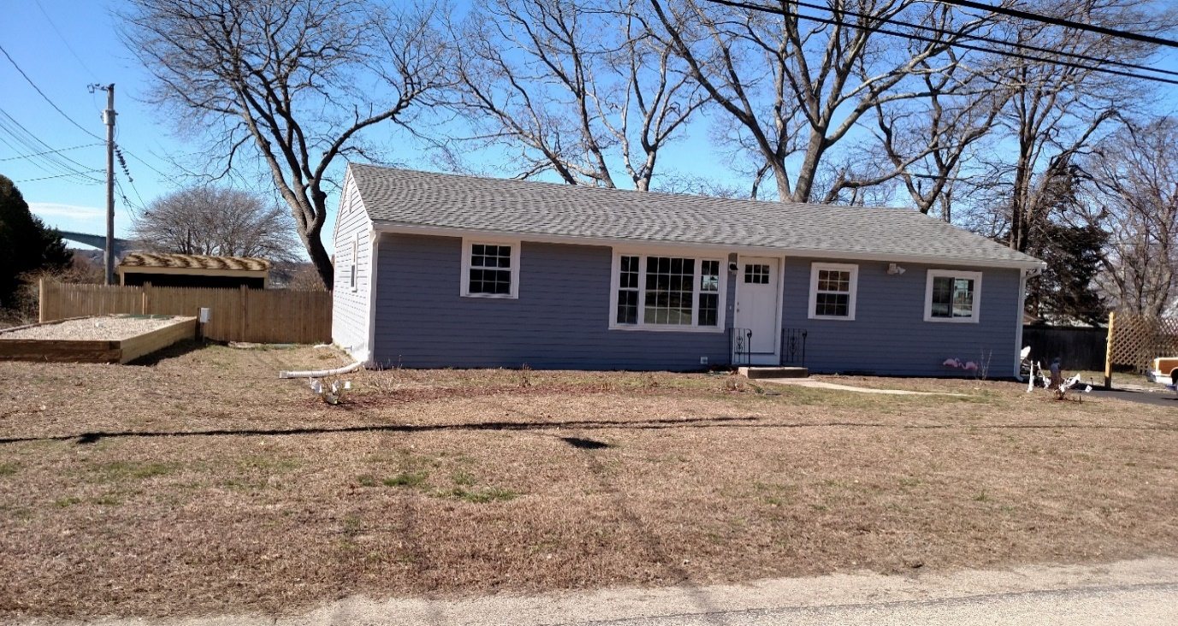
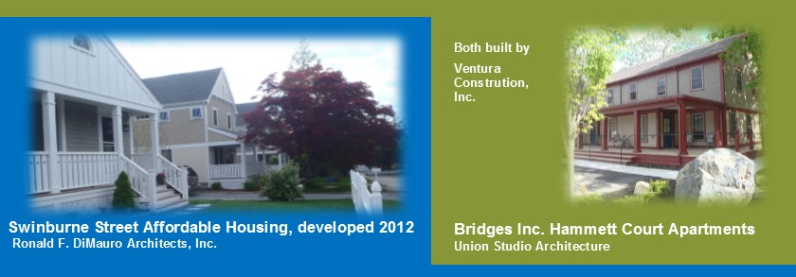
Beach Avenue
Affordable Unit
Affordable Housing Revolving Fund
Program formed: 2016 – Budget of $400,000
Expenditures: $122,632.00 (Beach Ave.)
Revenues: $122,632.00 (Beach Ave.)
Program Balance: $400,000 available
Committed to Carr Lane Project - $400,000
No available balance at this time for allocation.
Affordable Housing Grant Fund:
Balance will total approximately $30,000 - $35,000 after transfers for Carr Lane project until such time the $110,000 is repaid upon sale of individual units.

Slide 20
Information Technology
FY 2019-2020 Project Costs: $53,500
Fiber Network – Final Phase (Water Division/Library): $10,500
Information Technology – Annual Program: $23,400
Workstation Hardware/Software Upgrade: $19,600

Slide 21
Fiber Network Cable Project Phase IV
Project Cost: $10,500
This project will complete the construction and installation of the Town’s fiber network between all major Town facilities and is the last segment needed to provide a continuous fiber network ring around the Town.
The principal goal of establishing a continuous fiber cable network is to provide uninterrupted network services in the event of a fiber cable break or equipment disruption at any single location on the ring. The key services provided to all Town Departments over this network include telephone, Internet, email, security, telemetry and business continuity.
This new fiber network segment will run between the Water Department and the Library using aerial cable along North Road. The distance spanned is approximately one mile and when completed, the Town will have 4.8 miles of fiber network that can be used for all municipal purposes.

Slide 22
WORKSTATION HARDWARE AND
SOFTWARE UPGRADE
Project Cost: $19,600
On January 7, 2020, Microsoft ceases to provide security updates for Windows 7;
Prior to this date, all viable Town computer workstations must be updated to Windows 10;
System is vulnerable to high security risk and needs to be updated in FY20 – FY21;
FY2019-2020 IT request provides funding for the replacement of 5 workstations and software;
This request does not provide funding to do mandatory upgrades for certain other Town Departments, including Water, Sewer, Fire and Library.

Slide 23
Information Technology – Annual Program
Project Cost: $23,400
Desktop/portable workstations distributed throughout five buildings currently totals 57 machines;
Overall average machine age is 6.07 years, which is a 11% increase in average asset age from FY18-19;
This inventory assessment does not include servers and workstations located in the Police, Fire and Library Departments.
Budget is 38% less than the original forecast expense for FY19-20. The substantial change is due to reclassifying certain previous IT expenses from capital to operating.
Reclassified expenses include Town-wide Internet and communications services, Town website content provider software maintenance and Internet service, Internet content filtering service, network router maintenance and network support services from OSHEAN.
Additional reclassified expenses include satellite-based Internet backup service and certain software maintenance costs for telephone and email software support services that are used by all Town departments.

Slide 24
Information Technology – Annual Program
Town Policy is a minimum 5-year life cycle for workstations, with an 8 year policy for servers and network switches.
Other networking infrastructure and support equipment are in service for longer intervals until replaced by refurbishment cycles or when retired from service.
Any decision to replace equipment is also determined by out-of-warranty repair costs, new requirements, applications support and software upgrades.
More than 70% of budget to be used to replace workstations, servers and network equipment that fails or has reached the end of its life cycle during this period and for new equipment to maintain the Town’s technology base.
Budget also provides for replacement peripherals such as printers and external hardware, printing supplies and ink and other support equipment.
Focus on opportunities to reduce Town technology expenses, consolidate certain IT functions and contract for IT services when necessary.

Slide 25
Police Department
FY 2019-2020: Project Cost $42,500
Average mileage on a patrol unit annually is 27,000 miles. A Patrol Vehicle has approximately 136,000+ miles at time of replacement;
In 2013, Department transitioned to purchasing the Ford Interceptor sedan all-wheel drive vehicle;
In 2016, Department purchased and deployed the Ford Interceptor SUV model. The SUV is now the preferred model by law enforcement and makes up approximately 80% of Ford police vehicles;
The SUV model offers additional interior space which becomes increasingly necessary as equipment demands such as printers, computer, AED, patrol cameras and other equipment needs continue to increase.

Slide 26
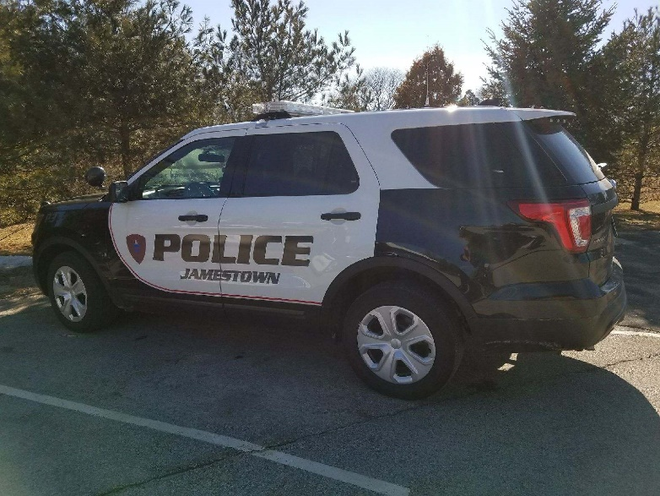
Police Department
9 Vehicle Fleet
Crown Victoria
Taurus
Ford Interceptor SUV
Ford Fusion

Slide 27
JFD Fire and EMS Services
FY 2019-2020: Project Cost: $81,420 Call Box Replacement Program $35,000
Radio and Pager Replacement 800 Mhz: $ 5,220 Facility Improvements - Main Station: $ 5,000
Phase I – Radio Call Box Conversion: $25,000 Personal Protective Equip. (PPE): $11,200

Slide 28
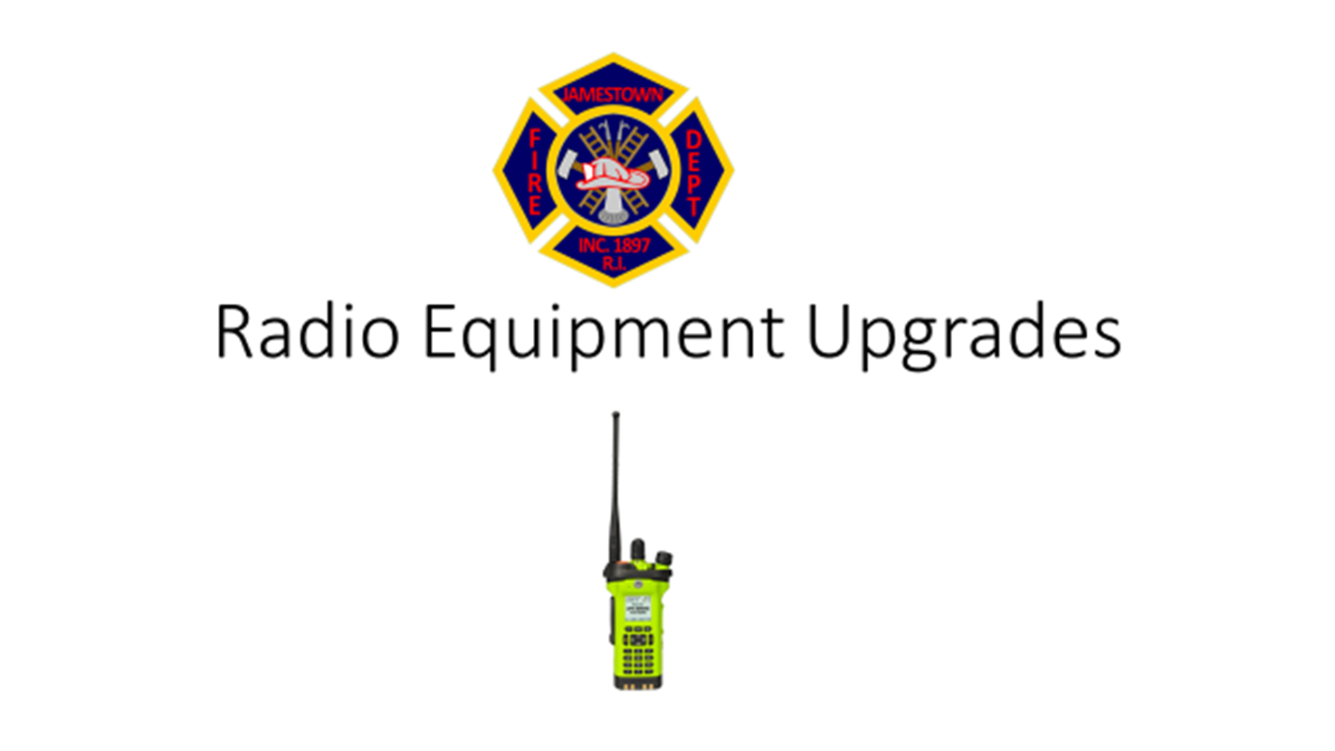

Slide 29
Radio System Upgrades
Fire Department has VHF mobile and portable radio units;
The Department has been in the process of transitioning to the State (RISCON) 800 mhz radio system since 2006.
Department is continuing to acquire additional portable radios to completely transition to the 800 mhz radio system;
The 800 mhz radio system is a statewide interoperable radio network;
Two neighboring Departments - North Kingstown and Newport solely operate on the 800 mhz system and during any statewide emergency;
Mutual Aid incident or Marine Incident all responding agencies operate on the 800 mhz system;

Slide 30
Radio System Upgrades
Current VHF system in place since the 1960’s;
Reception is inadequate with severe communications challenges;
JFD would continue to maintain the VHF system as a back-up radio system in case the 800mhz system was down or not operating.
System operates off of “site antenna towers” located around the State;
JPD has been operating on the 800 mhz system for several years;
Some “dead spots” exist with the 800 mhz system although there are considerably less when compared to the current VHF system;
Transitioning to the 800 mhz system with significantly improve our Firefighters/EMTs safety when operating at emergency incidents.

Slide 31

Jamestown Fire Department
Fire Alarm Replacement Project
FY 2018-FY2020

Slide 32
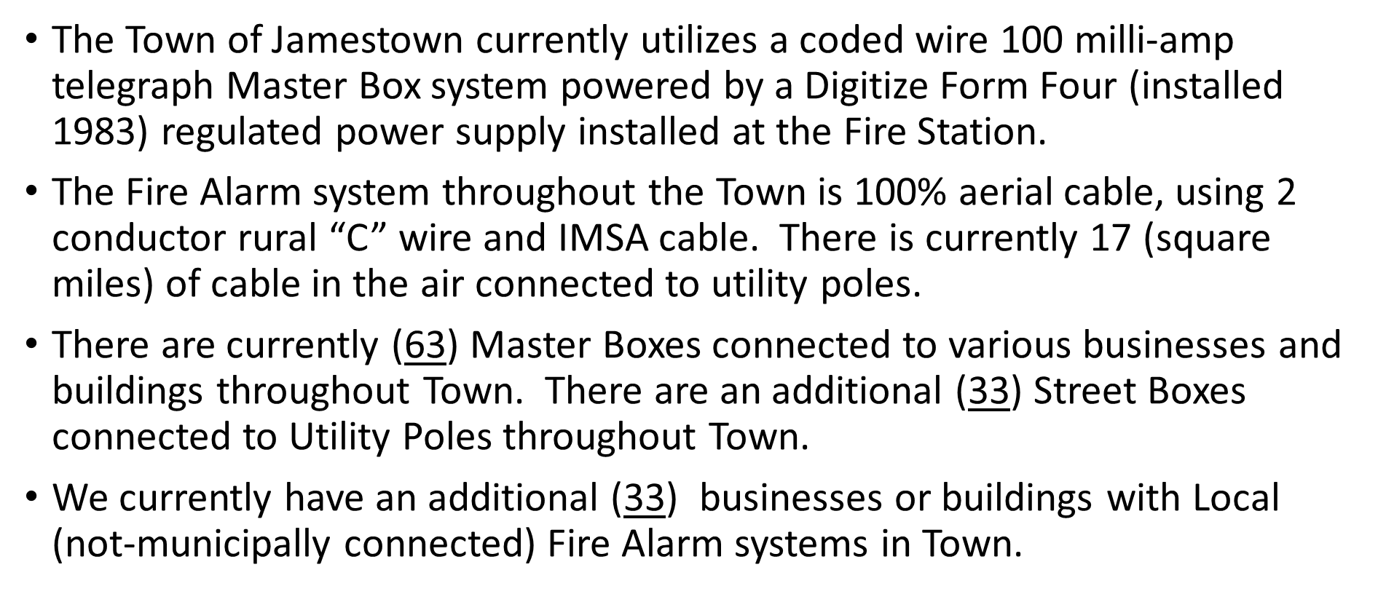
Conversion to Radio Call Boxes

Slide 33
AES Wireless Radio Fire Alarm System
The proposed Wireless Radio Fire Alarm system would create a private wireless mesh radio network to transmit Fire Alarm signals from a location to the receiving equipment in the Fire Station;
Numerous communities in Rhode Island have discontinued their “Telegraph” reporting systems and converted to Wireless Radio systems over the past 25 years due to the long-term advantages of reduced cost and lack of trained personnel to maintain cable plants;
The Town would no longer have to maintain the cable plant, the infrastructure and receiving equipment at the Fire Station would be replaced to current day technology.

Slide 34
Disadvantages of Current system
System is almost 68 years old. To maintain the system a significant capital outlay will be needed over the next 5-10 year period to replace the cable plant, the receiving equipment and the infrastructure in the Fire Station.
One significant weather event could result in significant damage to the cable plant. Though the system is operating, it is showing significant wear and tear.
We no longer have “volunteer” personnel to maintain the cable plant. No maintenance work has been done on the cable plant in several years. If a cable issue or problem occurred today we would have to hire an outside contractor to complete the work.

Slide 35
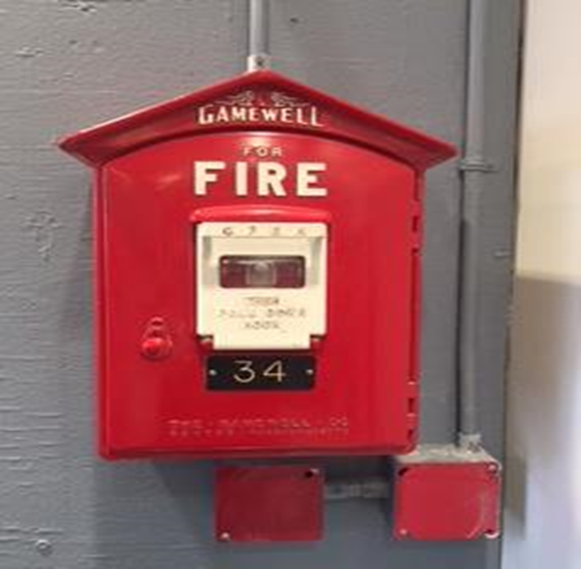
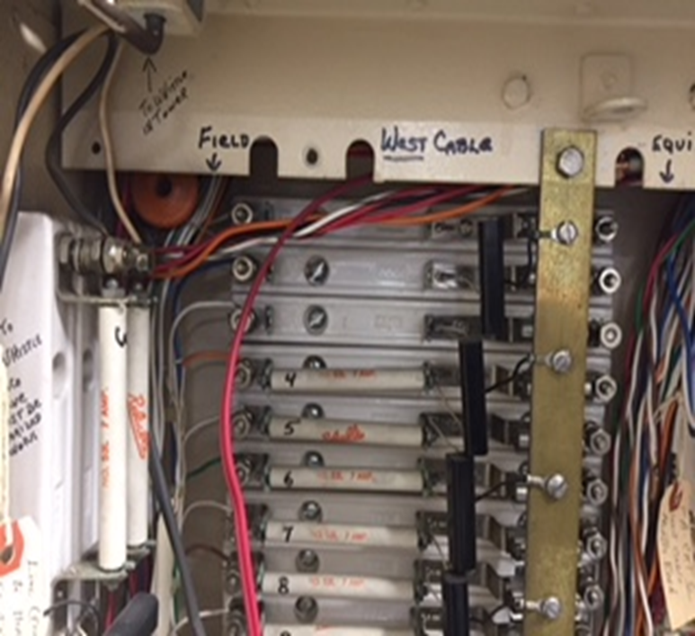
Current Fire Alarm Master Box’s Current Infrastructure - Cable Plant Box’s in Town Connects into Fire Station

Slide 36
Project Cost: FY2019-2020 - $25,000
FY2019 – Project Cost $50,000
This initial investment would purchase and install the new AES multinet Wireless Radio Box receiving system in the Fire Station. It would also address the cost to interface and connect to the Police Station dispatch center and address the technical configuration, programming and testing of the System.
FY2020 – Project Cost $25,000
The FY 2019/20 request of $ 25,000 would purchase and install an additional Digitize 3505 alarm receiver and decoder so the system would be redundant. The current Digitize 3505 receiver was installed in 2009.

Slide 37
Project Cost – continued
Several communities who have switched over to the Radio Call box systems have offered some assistance to business/property owners, some options include:
    Municipality addressed initial cost of the Radio Boxes and installation and offers a payment program over a multi-year period;
    Potential for bulk and coordinated pricing agreement with installation could potentially generate cost savings for all parties;
    Extended notification timeline for installation offered - a one or two year notification period is provided and the property/business owners have a hard operation date where the Town switches over to the new system, with all required costs paid by property owner;
    Once a decision is made several educational meetings will be scheduled with local business and property owners as to why it is important to make this transition;
    Business/property owners maybe able to receive a trade-in credit or sell their current Gamewell Master Box at an estimated value of $ 200-$300.

Slide 38
Personal Protective Equipment and Other Equipment
Project Cost: $5,220
Radio Pagers: Only means of contacting members for Fire and EMS,
received a pager. Currently on hand 115 pagers: 2005 – 60, 2009 – 30,
2014 – 25. Pager Cost: $509/each – (10-12) pagers per year are replaced
mainly due to damage and age.
Project Cost: $11,200
Personal Protective Equipment (PPE) - Cost for a complete set is $2,000.
Every member received a complete set of PPE. This includes, Helmet, nomex hood, jacket, pants, boots and flashlight. Trainees are given older sets until they become a full member. PPE is replaced due to wear, damage and a member becoming full-time active. Older equipment is repaired and made available, should it be needed.

Slide 39
Public Works Department
FY2019-2020 Project Cost: $365,000

Slide 40
Road Improvement Program
Program Overview:
In November 2006, a Pavement Management Program was implemented to inventory the condition of Town roads every 5 years, with the last inventory having been performed in November of 2017.
In December 2014 the data from the November 2011 inventory was updated to reflect the paving that has occurred since 2011 and this summary is presented to the Town Council for FY 2018-2019 budget consideration. The inventory does not take into consideration road deterioration that has occurred since that time, thus costs will be greater than indicated.
Road Assessment: The procedures used to assess road conditions focus on evaluating pavement based on various levels of distress. This data was collected by Town DPW Staff based on the Roadway Pavement Management System (RSMS) developed by the T2 Center at The University of New Hampshire and the Distress Identification Manual for the Long-Term Pavement Performance Project, developed by National Research Council’s Strategic Highway Research Program.
After the field inspection, the program assigned a Pavement Conditions Indicator (PCI) from 0 (poor) to 100 (good), based on the amount of distress that exists on the road surface. The score value and pavement history is used to develop a priority paving and road improvement list, to track the effectiveness of maintenance techniques and processes from year to year.

Slide 41
This table summarizes the cost to apply the appropriate repair method to the road segments. The repairs would return each segment to acceptable condition (PCI ≥ 90).
PCI
Range
# of
Segments
Repair
Method Area (SY)

Slide 42
Maintenance and Repair Costs

Slide 43
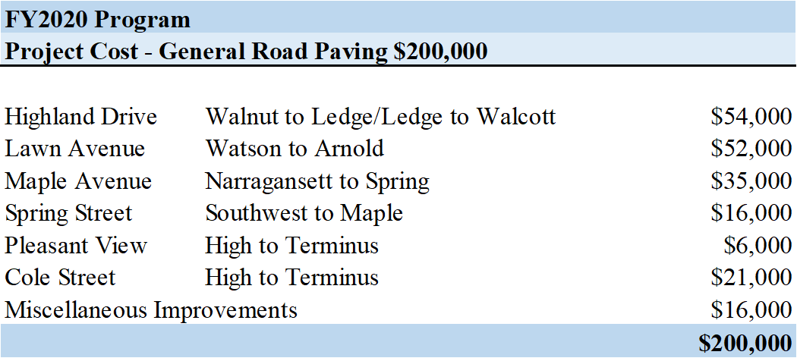
Maintenance and Repair Costs

Slide 44
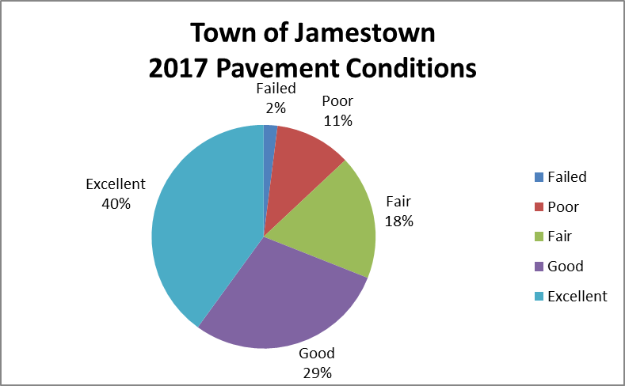
VI. Summary
Current efforts to improve the pavement conditions in the Town have been effective in that the inventory of roadway surfaces in the good and excellent categories has increased to 69%, an increase from 44% in 2007 and 47% in 2011. Reference the charts and graphs exhibiting the changes over time.
2017 Road Conditions

Slide 45
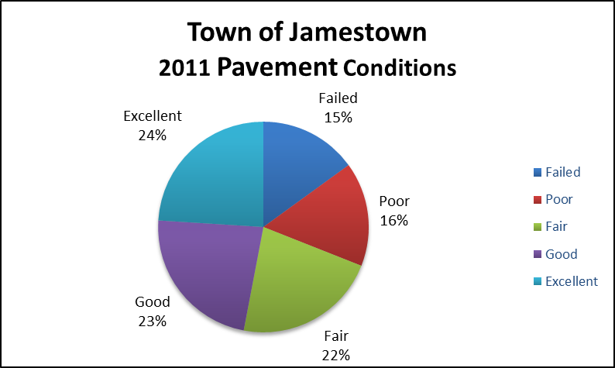
2011 Road Conditions

Slide 46
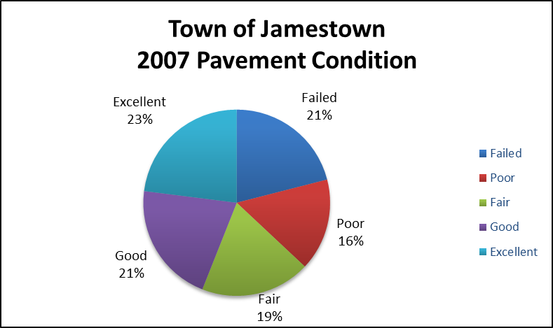
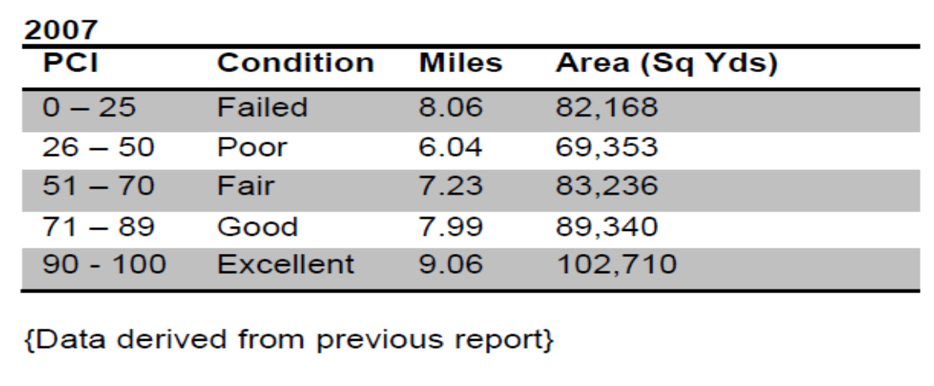
2007 Road Conditions

Slide 47
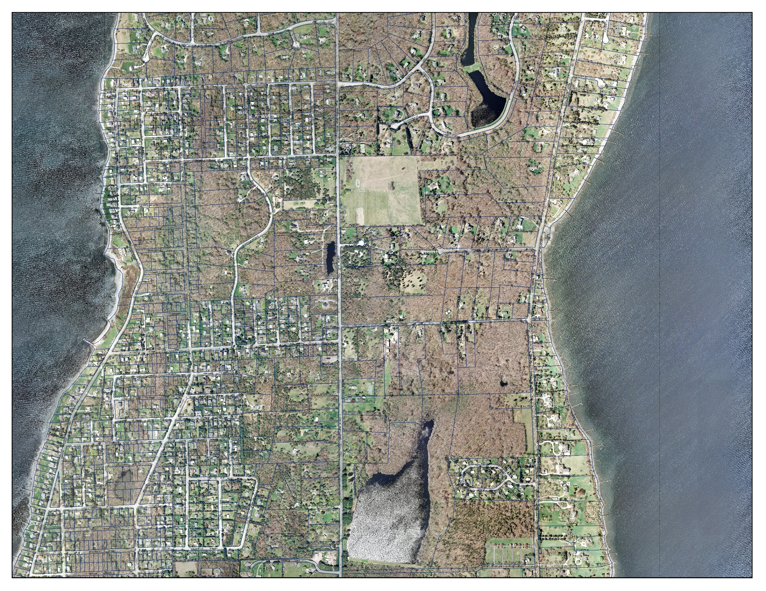
North Road Project
Final Phase
Project Cost $75,000
PHASE IV
Construct Shared bike/pedestrian path from America Way to North Pond
2019 Project

Slide 48
Road Drainage and Street Repairs
Road Drainage: Annual Project Cost $20,000
This program provides funding to purchase materials for drainage structures that require maintenance and repair from the annual catch basin inspection and cleaning program. Drainage improvements are necessary at various locations in town. This work is required before roads on the resurfacing list can be scheduled for repaving.
Street Repairs: Annual Project Cost $15,000
This program funds needed repairs that develop and/or complaints filed regarding deteriorated road conditions. This work involves patching, asphalt berms and apron installations. Typically one truck load (7-tons) of asphalt per week during the season of (24 weeks) is used.

Slide 49
Sidewalk Repairs and Replacement
Project: $20,000
It is recommending that the $20,000 be used to continue the installation of ADA curbing and ramps at various locations in addition to routine repairs at various areas throughout the community.
Capital Funding Alternate Funding
Intersection of Union Street Safe Routes to School Program
Bank Newport Driveway East Ferry Project Sidewalks
Lincoln Street
Friendship Street
Brook Street
High Street
Hamilton Avenue
Asphalt needs to be replaced on the sidewalk on the westerly side of Walcott Between Brook Street and High Street.
Continuation of maintenance program with concentration on trip and fall hazards and long range plan development to address the easterly side of Walcott Ave. between Hamilton Ave. and Fort Wetherill Rd. that remains in very poor condition.

Slide 50
Sidewalk Conditions Plan
North of Narragansett Avenue
Sidewalk Conditions Plan
South of Narragansett Avenue

Slide 51
Public Works Carpenter Shop Development
Project Cost: FY 2019-2020 - $20,000
(Total Project Cost $40,000 funding)
Construction of a small carpenter workshop building adjacent to the salt storage barn. Funding will be used to purchase materials with construction of this metal building being handled in-house by the Town workforce.
The addition of the shop will allow for projects to continue through the winter months in avoiding the trucks and equipment that are stored inside the main garage thus limiting the area that can be effectively utilized during this heavy work period.

Slide 52
Geographic Information Systems
FY2019-2020 Project Cost: $5,000

Slide 53
Geographic Information Systems
GIS Goals:
Continue with Utility database and mapping;
Coordinate Parcel Mapping and updates;
Update accuracy of Parcel Mapping;
Complete PHASE II, CMOM, and TIER II annual reports as required by EPA;
Increased focus of mapping integration with new municipal website;

Slide 54
Phase II Stormwater Management
Project Stormwater Management : Phase II Requirements
The Town is an RIDEM designated municipal separate storm sewer system (MS4) and as such is required to have a RI Pollutant Discharge Elimination System (RIPDES) Permit to comply with EPA’s Clean Water Act regarding the discharge of stormwater runoff through the Town’s drainage system to Narragansett Bay. As part of the permitting process, regulated municipalities are required to have an approved Stormwater Management Plan and submit an annual report that demonstrates how the Town implements strategies to reduce the discharge of pollutants from the storm sewer system to the “Maximum extent practicable”.
Specifically, RIDEM requires that the Town address the following six (6) minimum measures to protect water quality.
1. Public Education and Outreach 5. Post-Construction Runoff Control
Public Participation / Involvement 6. Good Housekeeping / Pollution Prevention
Illicit Discharge Detection and Elimination
Construction Site Runoff Control

Slide 55
Parks and Recreation
Fort Getty Projects $50,000
Vehicle Replacement Program: $40,000

Slide 56
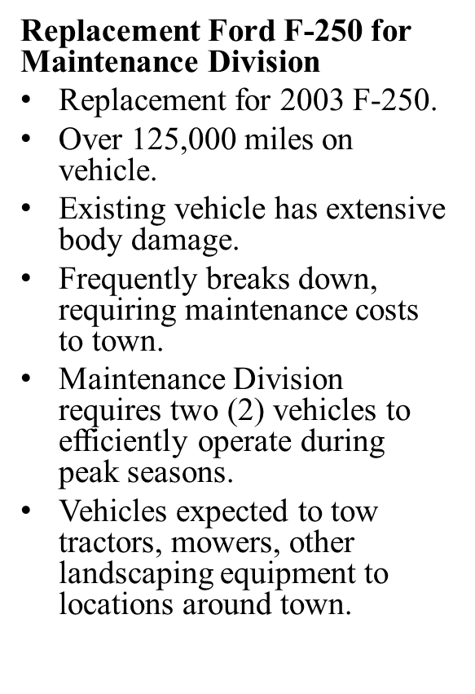
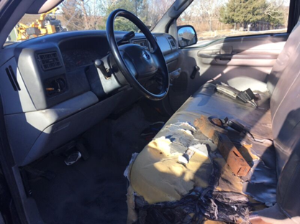
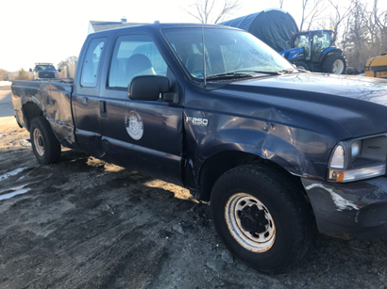
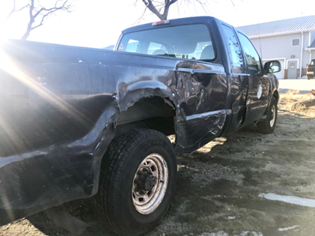
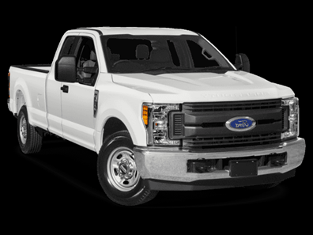
Parks Division Equipment
Project Cost: $40,000 Parks Division utilizes a two member full-time maintenance crew, supplemented with a part-time seasonal workforce.

Slide 57
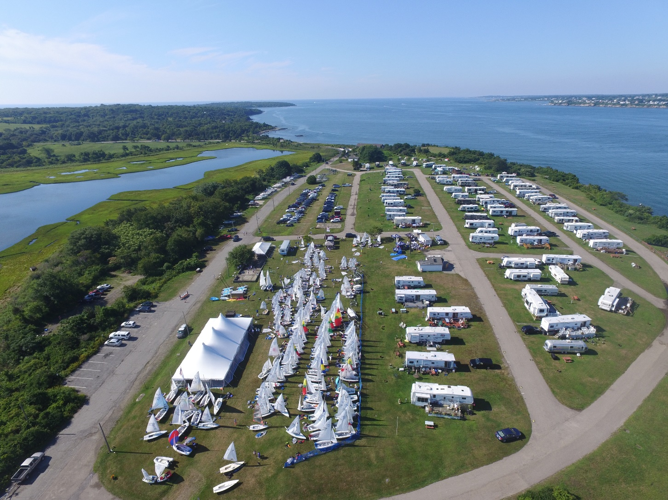
Fort Getty Improvements

Slide 58
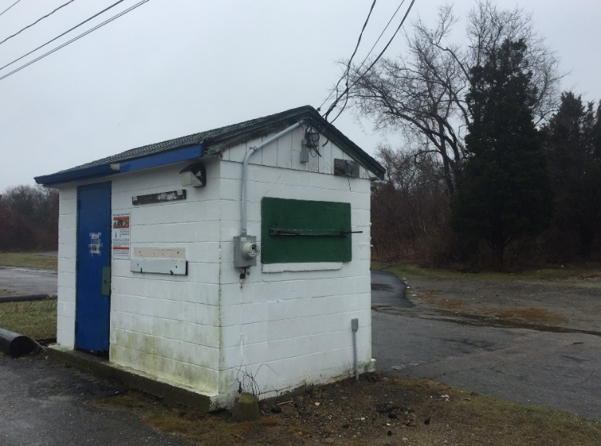
Park Priority Areas
Project Funding FY2020 $50,000
Target Areas for Improvement:
1)Building Improvements
  Gatehouse
    Restroom Area/Office/Storage
  Lower Restroom Rehabilitation
      2) Waterfront Improvements
      (Harbor Commission)
        Pier Improvements
        Balancing Recreational and Commercial Uses

Slide 59
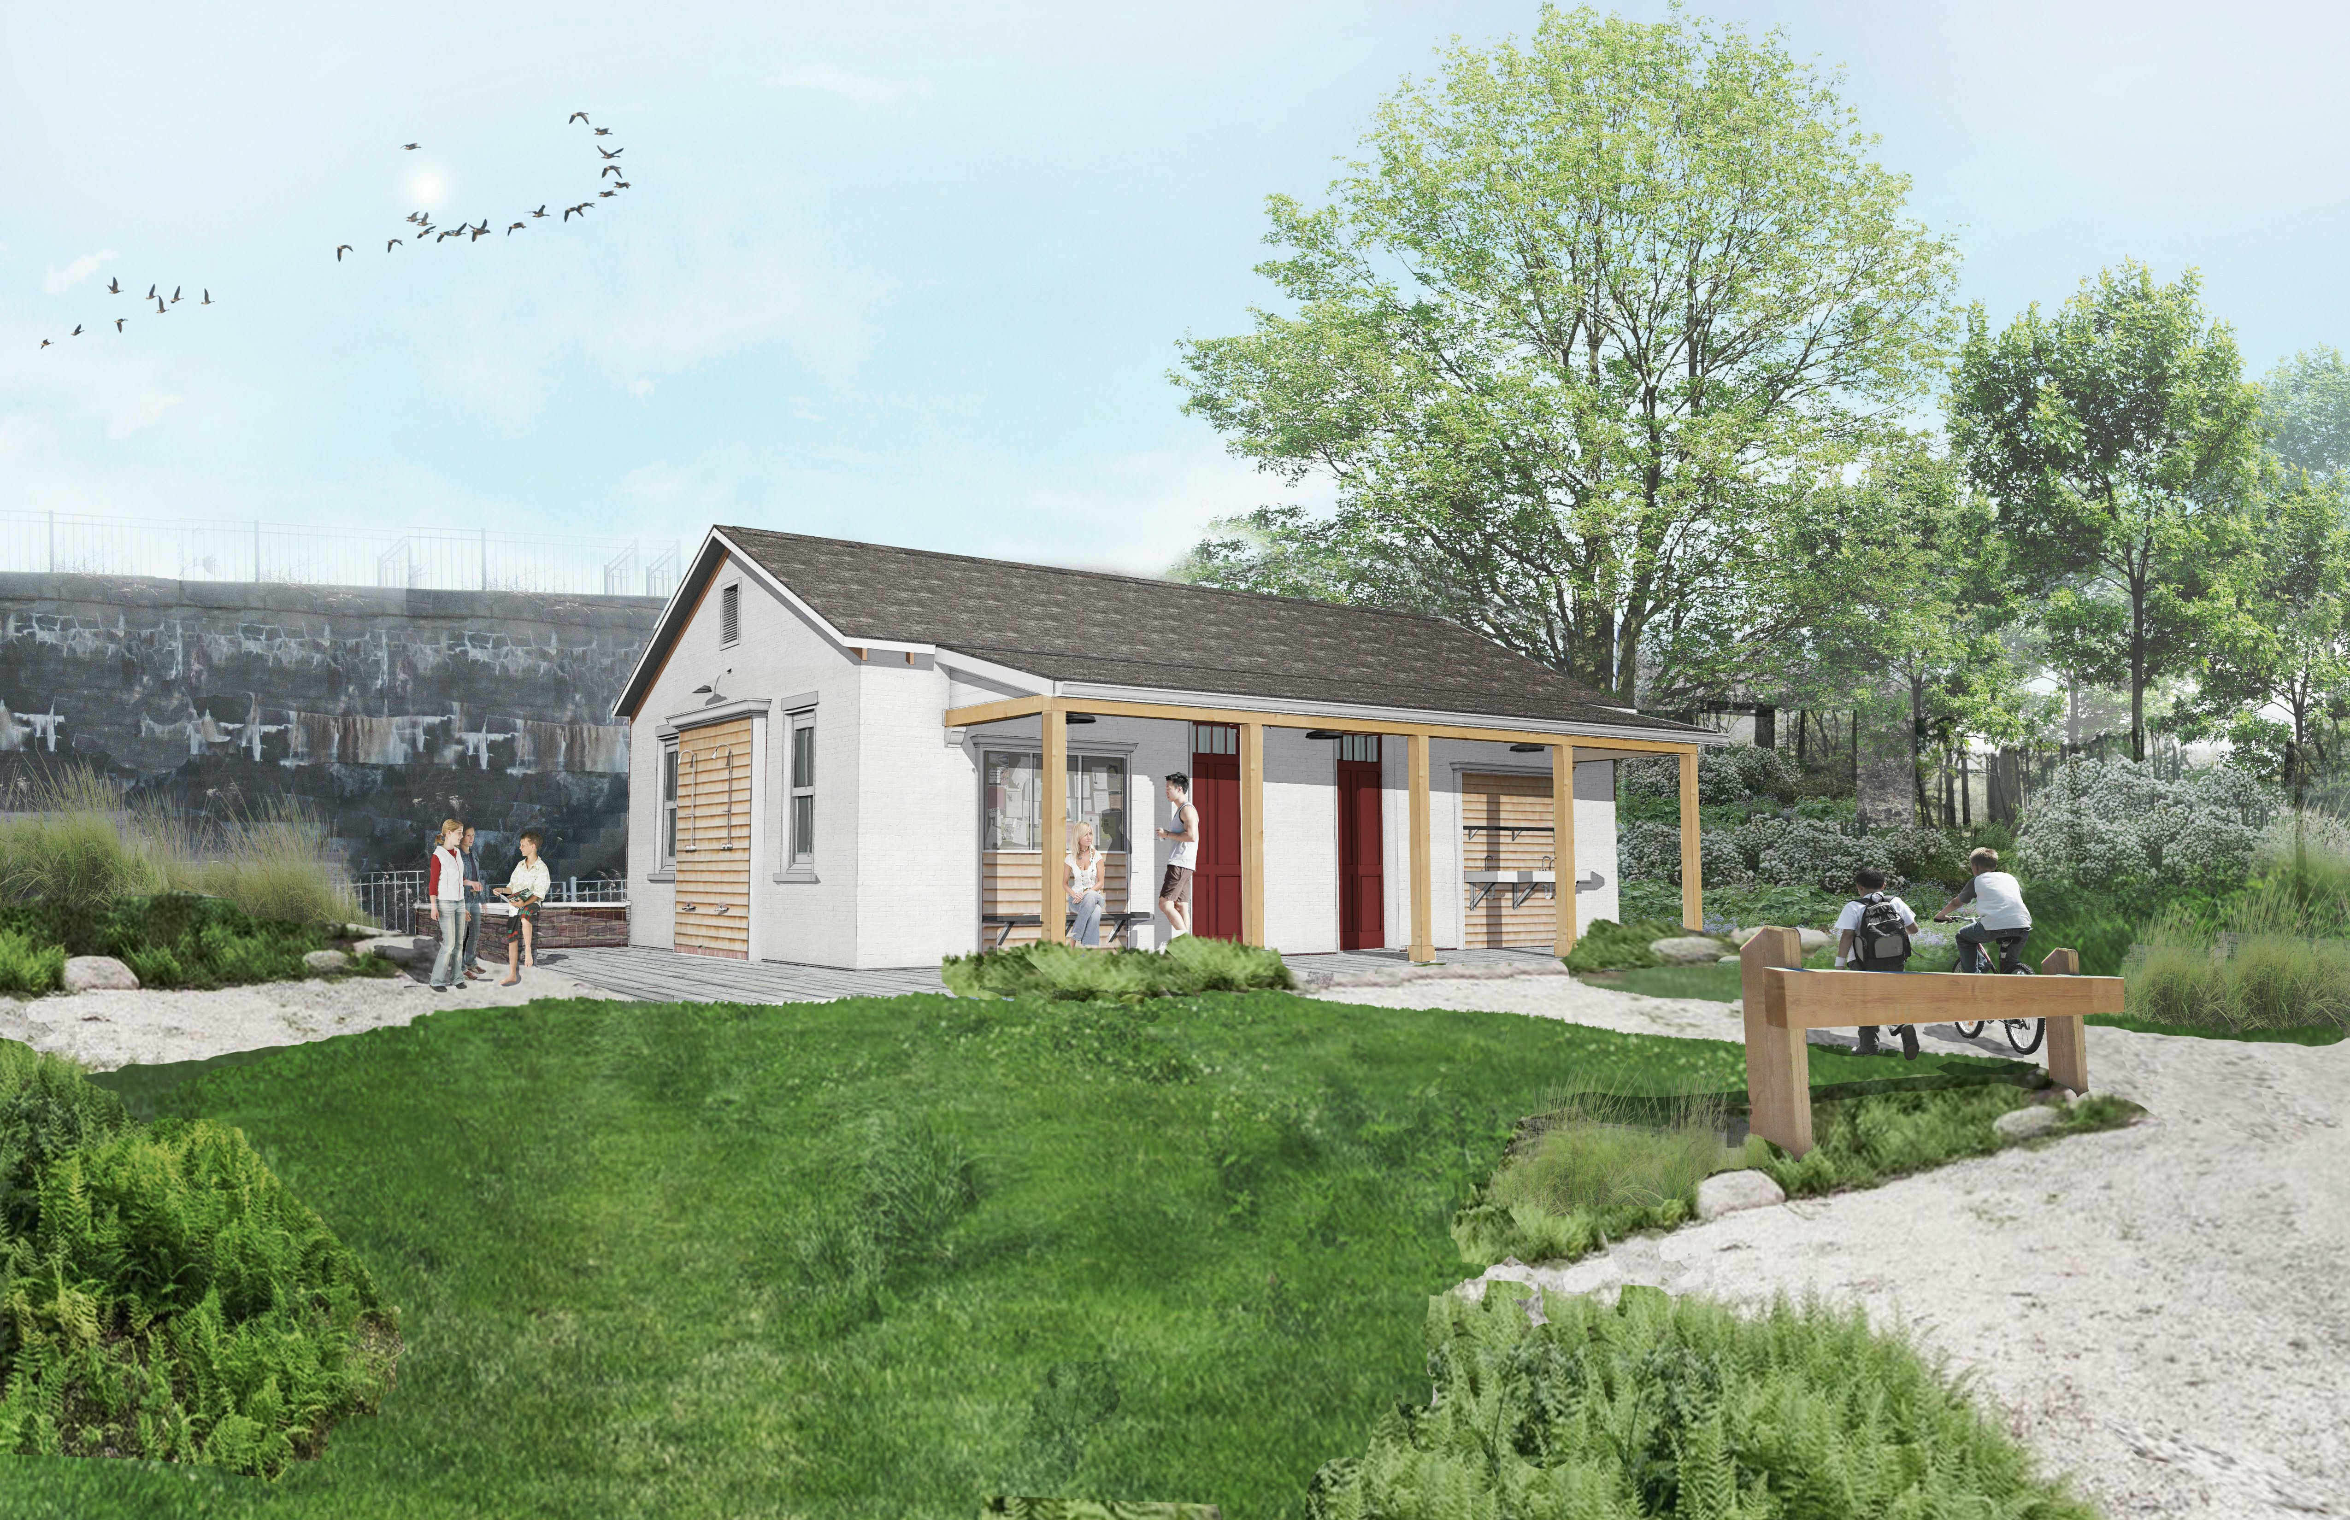
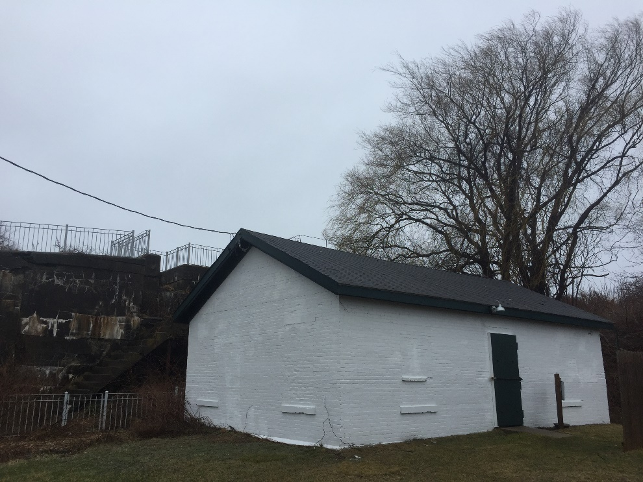
Public Restroom Buildings
Lower Restroom Building

Slide 60
Senior Services Department
Project Cost: $20,000 Duct Replacement/Removal and Sound Proofing

Slide 61
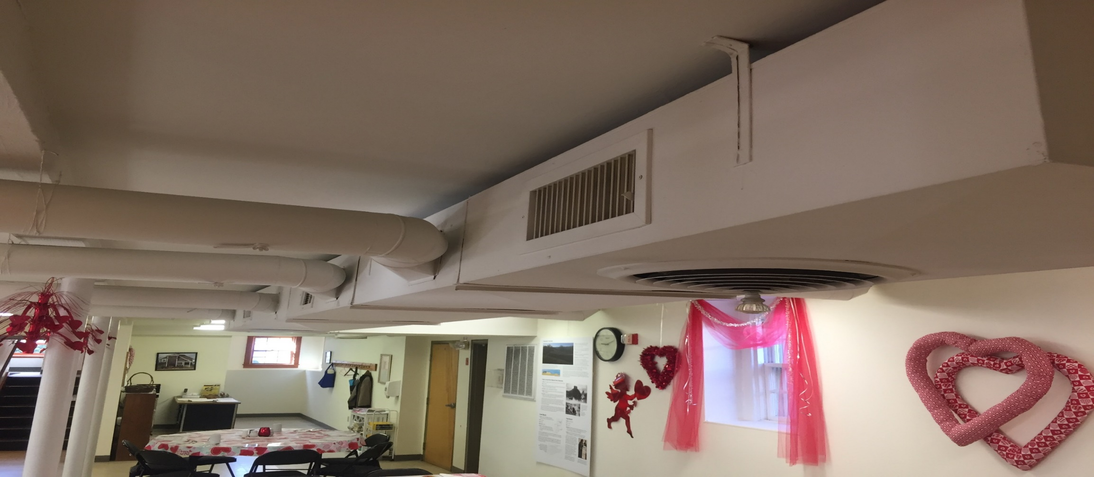
Senior Services Department
Duct Replacement/Removal and Sound Proofing

Slide 62
Debt Supported Long-term Projects
School Construction (Budget Review March 21st)
Golf Course Clubhouse (Issuance in 2019)
Library Rehabilitation (Authorized, Not Issued)
Equipment Acquisition (Proceed in 2019)
Municipal Solar Installation (Proceed in 2019)

Slide 64
Golf Course Clubhouse

Slide 68
BUILDING SPACES | EXISTING BLDG. | PROPOSED BLDG.
DIMENSION OF BUILDING | 55’ x 90’ | 50’ x 65’
ROOF OVER GOLF CART STORAGE | N/A | 40’ X 45’
First Floor | 4,476 sq. ft. (includes club house, storage, office, dirt floor basement areas and un-excavated crawl space) | 2,915 sq. ft.
First Floor (Golf Course) | 2,771 sq. ft. (club house) | 2,915 sq. ft.
First Floor (Dirt Floor Basement – unexcavated) | 1,705 sq. ft. | N/A
Second Floor | 4,476 sq. ft. | 3,345 sq. ft.
FIRST FLOOR
Bar/Caddyshack | 1,300 sq. ft. | 1,149 sq. ft.
Bar Kitchen | 140 sq. ft. | 175 sq. ft.
Toilets | 100 sq. ft. | 278 sq. ft.
Golf Check In | 100 sq. ft. | 100 sq. ft.
Golf Desk | N/A | 53 sq. ft.
Office | 80 sq. ft. | 92 sq. ft.
Pro-Shop | N/A | 92 sq. ft.
Lobby | N/A | 268 sq. ft.
Circulation | 220 sq. ft. | 550 sq. ft.
SECOND FLOOR
Catering Kitchen | N/A | 225 sq. ft.
Mechanical/Electrical Room | 192 sq. ft.
Toilets | 155 sq. ft. | 102 sq. ft.
Circulation | N/A | 581 sq. ft.
Meeting Rooms/Public Space | 4,129 sq. ft. | 1,149 sq. ft.
Basement Mechanical |  | 300 sq. ft.
Basement Storage |  | 2,491 sq. ft.
Golf Cart Storage | 1,300 (under tent) | 1,800 (under roof)
Porches/Decks/Terrace | 600 sq. ft. | 2,700 sq. ft.

Slide 76
20 – Year Debt Schedule

Slide 77
Equipment Replacement Program

Slide 78
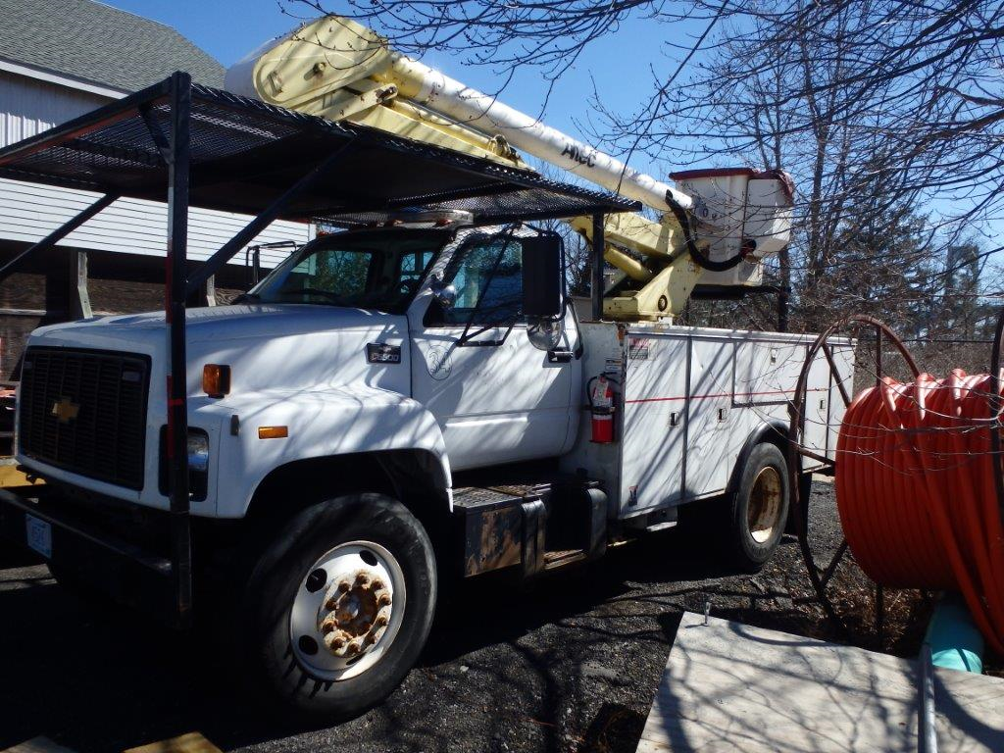
1998 GMC 6500 Bucket Truck
113,455 miles,
Failed safety inspection needs $20,000 in repairs;
Using Contracting Service;
FY19 Expenditures at $22,589 $7,589 over budget;
$2,000 charge per day for a crew to do work in Jamestown.

Slide 79
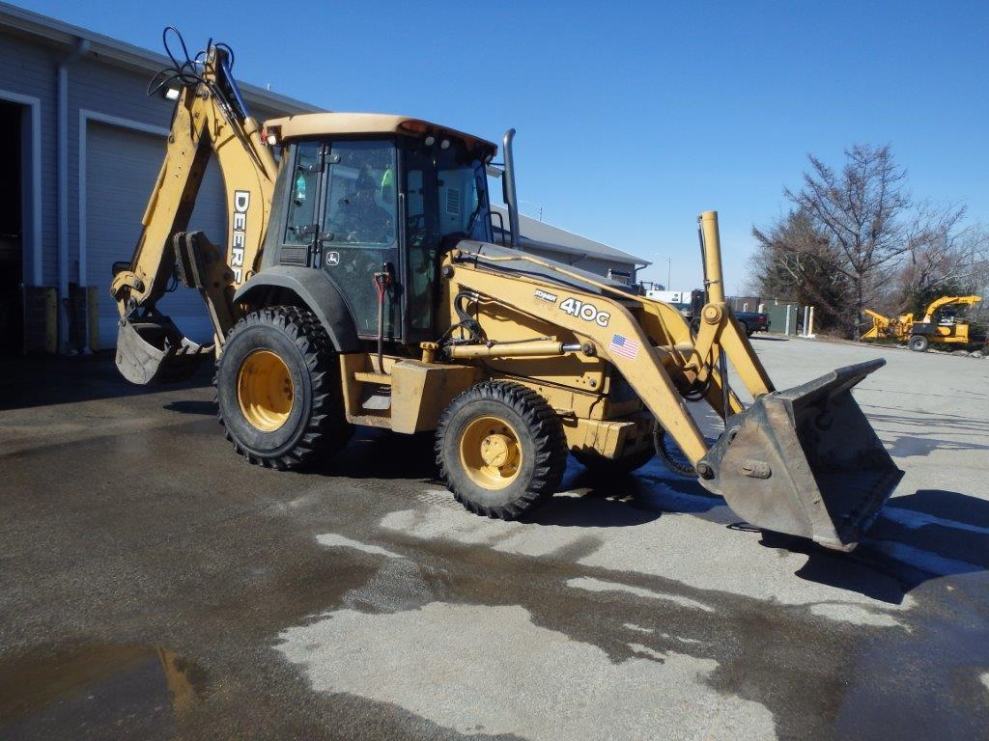
2006 John Deere 410 Backhoe
10,000 hours;
spent $31,487 on repairs over the past 4 years;
Primary piece of equipment on every project for highway or utility work;
This past summer the backhoe was down for multiple weeks for repairs on transmission, electronics, hydraulics;
Need a dependable machine at all time for emergency repairs etc.

Slide 80
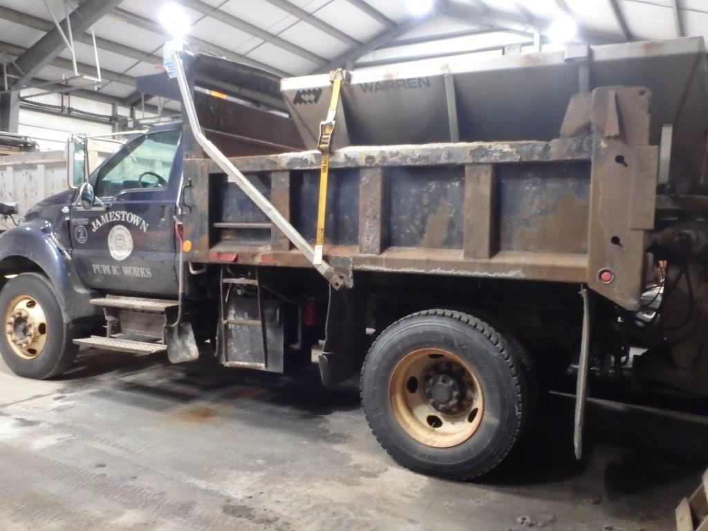
2006 F750 dump truck
73,934 miles;
Invested $8,178 in repairs over the past 4 years;
Dump body needs replacement;
Undersized at 26,000 GVW;
Replacement will be heavier duty at 33,000 GVW.

Slide 81
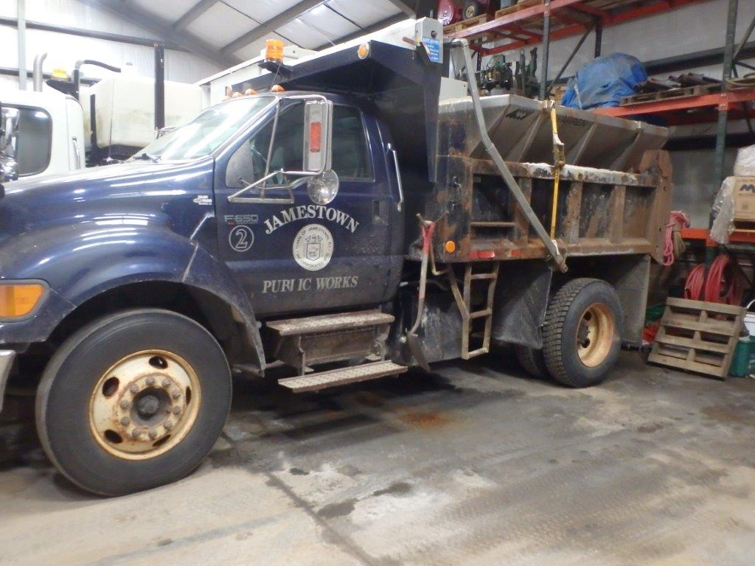
2006 Ford F650 Dump Truck
47,285 miles;
Invested $13,721 on repairs over the past 4 years;
Dump body needs replacement;
Truck is no longer dependable during winter storm events;
Failed during multiple storms and towed back to the garage;
Undersized for job requirements;
26,000 GVW truck;
Replacement will be heavier duty 33,000 GVW appropriate for fleet.

Slide 82
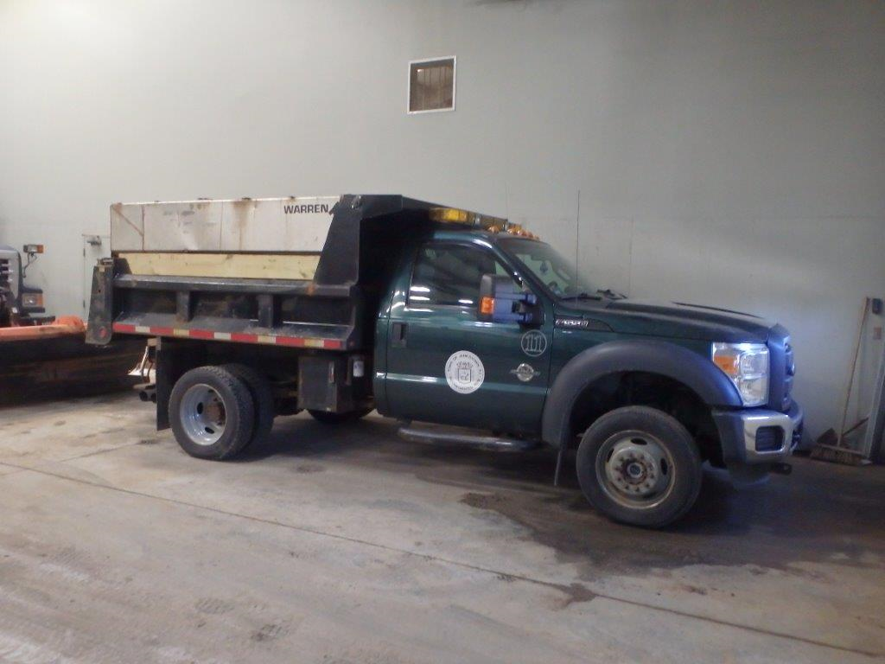
2012 F550 Dump Truck
47,285 miles;
Invested $9,226 on repairs over the past 4 years;
Dump body needs replacement
Truck is starting to rot.

Slide 83
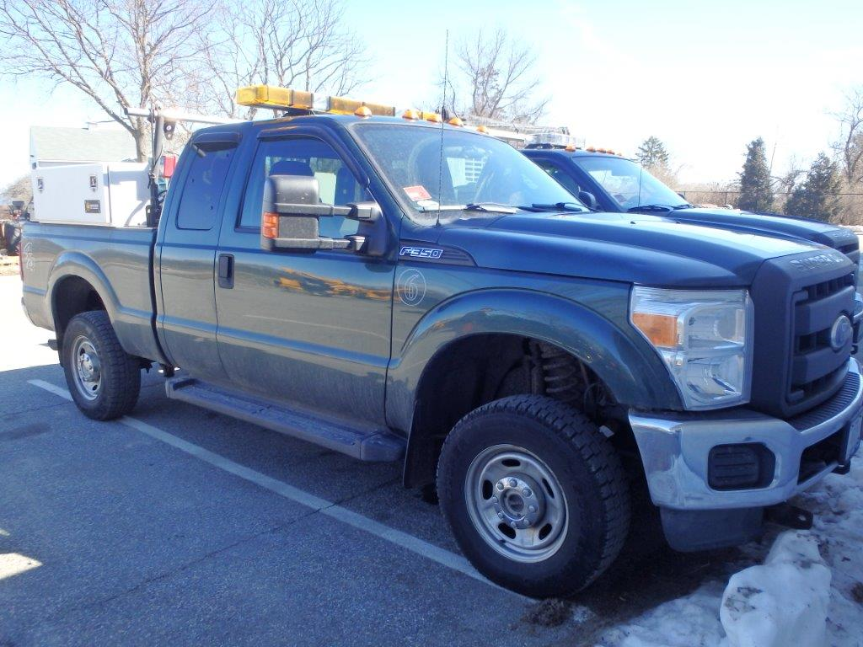
2012 F350 Pickup Truck
73,934 miles;
Invested $7,903 on repairs over the past 4 years;
Taken out of rotation for snow plowing and used by mechanic;
New Superintendent Vehicle;
2015 pickup to be rotated down to the mechanic and used for snowplowing, if needed.

Slide 84
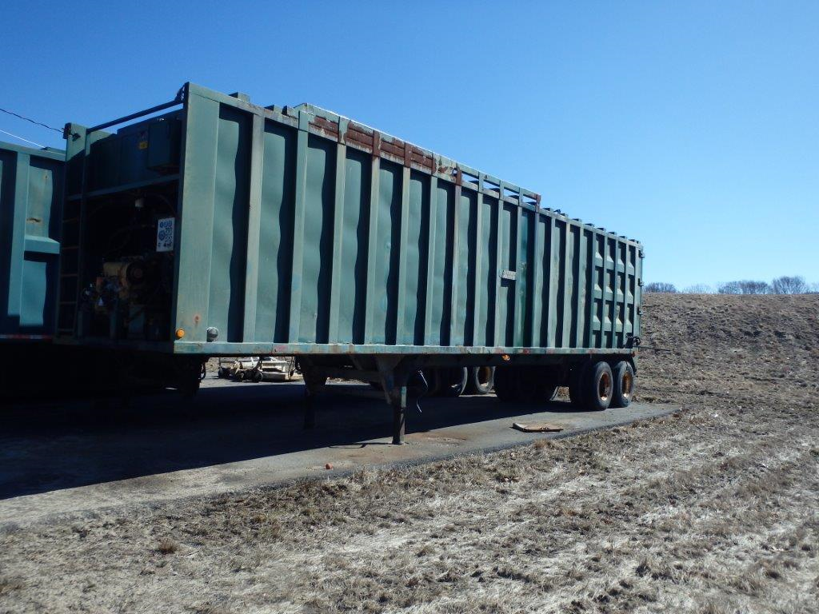
Transfer Station Compactor
Purchased in 1998;
Filled with holes along the bottom where trash dumps on the road between here and the landfill in Johnston.
Trucking company will not transport this trailer due to the potential liability.
Last year the one trash compactor we have required repairs leaving us without it for a few days.

Slide 85
3-5 Ton Roller
Enclosed Work Trailer

Slide 86
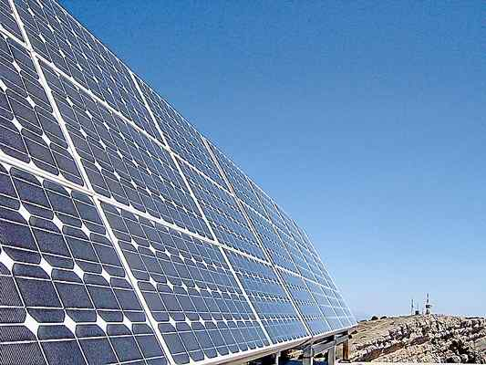
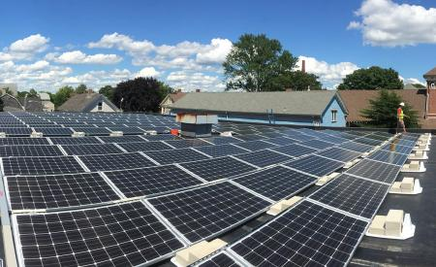
Professional Services (Energy Projects)
Feasibility assessment of various Town Facilities and property for the installation of roof-top solar arrays, including, Fort Wetherill, Fort Getty Pavilion, Highway Barn, Wastewater Plant, Transfer Station Property and the Lawn and Melrose Schools.

Slide 87
Solar Project Feasibility
Previously approved $25,000 in FY2017-2018 to determine the preliminary feasibility of several small roof top solar projects. This preliminary analysis provided information to allow for an informed decision as whether individual projects on each building will meet specific development goals. Tasks associated with this preliminary analysis included:
Feeder information request to National Grid, if needed to determine the feasibility of an interconnection with the electrical circuit at the site;
Develop layouts based upon current standards for NFPA and access to array sizing;
Structural analysis of the proposed array to determine the feasibility of construction;
Preliminary electrical study to determine the feasibility of the interconnection with the buildings electrical system;
This Study can now be used to develop a Request for Proposals to complete final design, engineering, and installation of solar projects on municipal buildings in Jamestown.

Slide 88
Municipal Building Assessment
Group 1:
Town Buildings Assessed Total Cost Grant Net Cost Payback Yr. 1 savings
Lawn Avenue Middle School $511,200 $80,000 $431,200 11.5 yrs. $33,092
Melrose Elementary School $386,575 $80,000 $306,575 11.1 yrs. $24,516
Jamestown Philomenian Library $170,100 $41,310 $128,790 12.8 yrs. $ 9,091
$866,565 $66,699
Group 2:
Highway Garage $184,920 $43,956 $140,964 11.4 yrs. $11,243
Fort Wetherill Parks Garage $139,860 $32,130 $107,730 10 yrs. $ 7,187
Recreation Center $ 81,000 $18,360 $ 62,640 12.6 yrs. $ 4,741
Fort Getty Pavilion $113,502 $25,704 $ 87,798 12.5 yrs. $ 6,511
$399,132 $ 29,682
Group 3:
Waste Water Plant $112,021 $25,398 $ 86,623 11.2 yrs. $ 7,265
Police Station $ 31,680 $ 6,732 $ 24,948 17.9 yrs. $ 1,616
Town Hall $145,604 $33,048 $112,556 15.3 yrs. $ 6,526
$224,127 $15,407

Slide 89
Fort Getty Pavilion Existing Usage: 115,578 kWh
Production: 41,152 kWh (35.61%)

Slide 90
Recreation Center Existing Usage: 29,907 kWh
Production: 29,907 kWh (100%)

Slide 91
Fort Wetherill Parks Garage
Existing Usage: 45,673 kWh
Production: 45,673 kWh (100%)

Slide 92
Highway Barn Existing Usage: 70,594 kWh
Production: 70,588 kWh (99.9%)

Slide 93

Group 1 Projects: Include cost within larger-scale projects as School Construction will generate a significant reimbursement through RIDE program during installation over the next two years and Library is best considered in concert with roof replacement element of large library building rehabilitation as that project takes shape also within the next few years.
Group 2: Recommendation is to borrow up to $500,000 over a 10 yr. or less debt payback schedule period. Four projects have estimated installation cost of $400,000 that would lower debt service costs by approximately 20%. With total principle/interest cost falling in the $460,000 range. Initial interest cost of $6,875 is proposed in FY2020 (avg. $6,000/yr.) along with annual savings of approximately $45,000 - $50,000 per year that will address debt costs over the 10 year period paying for full project debt. Interest will add approx. 3 yrs. onto payback schedule for each project.
Group 3: Do not proceed at this time.

Slide 94
Capital Program
Final Slide

