Slide 1
Jamestown Golf Course Clubhouse Facility
Town Council Meeting
April 3, 2017

Slide 2
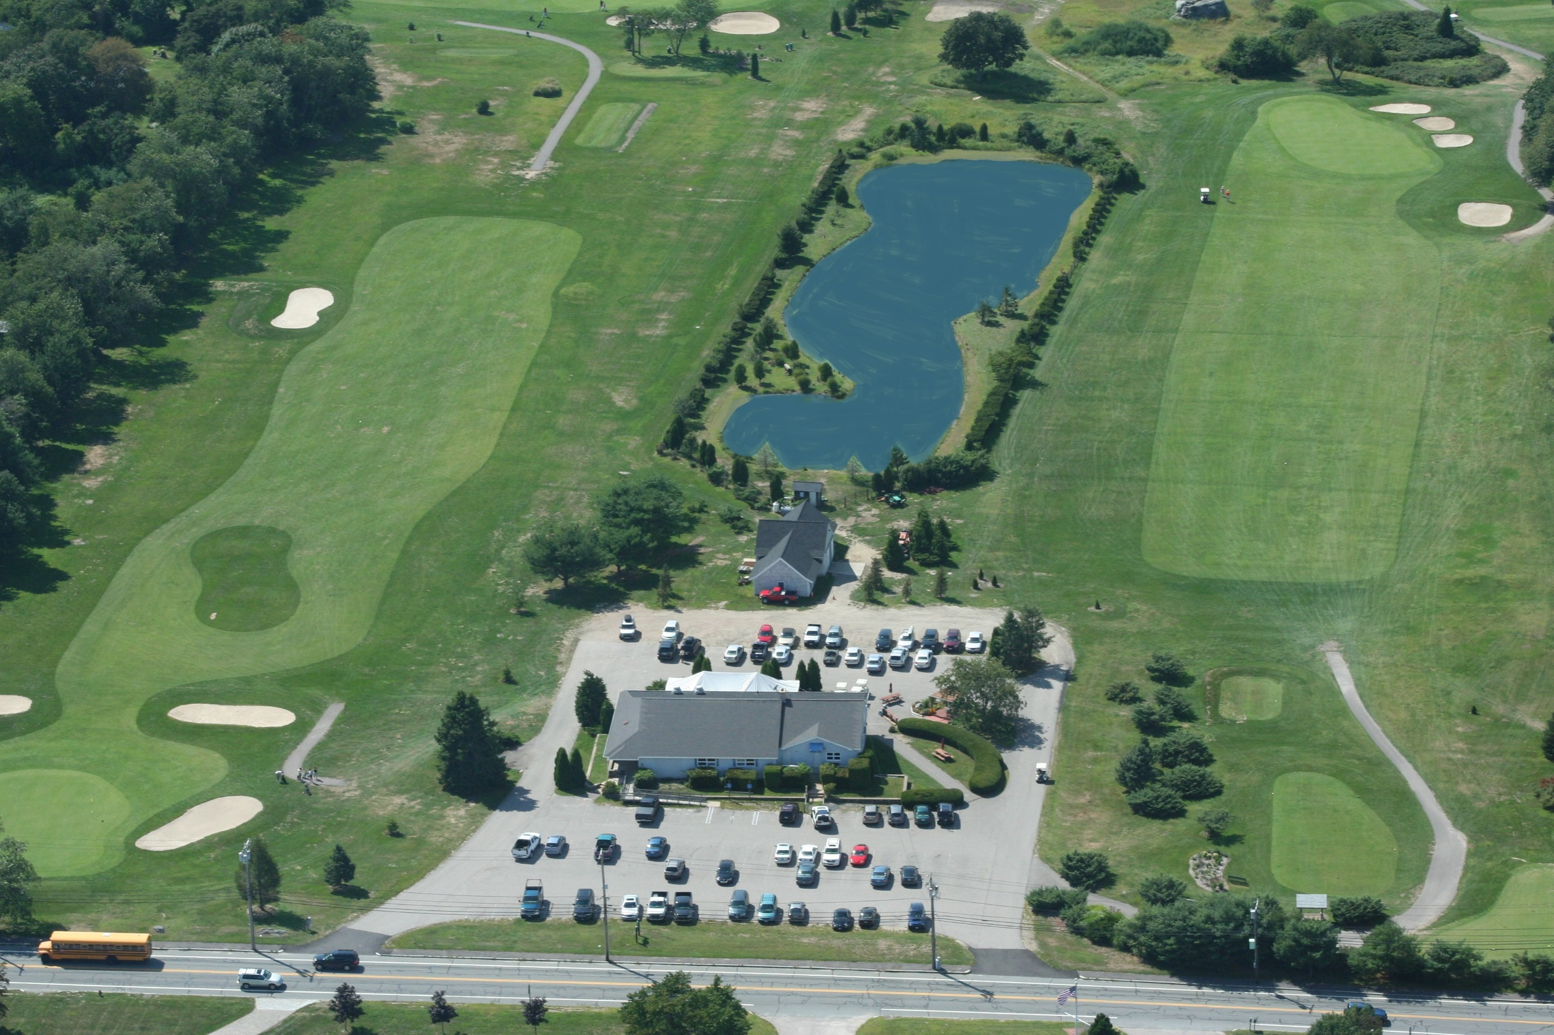

Slide 3

Jamestown Golf Course Clubhouse Facility
Actions:
What we heard on January 17, 2017:
  In favor of the building program including general layout and elevations
  Golf Course needs are primary while, if financially feasible, accommodating competing community interests
  Come back with a revised design and cost estimate

Slide 4

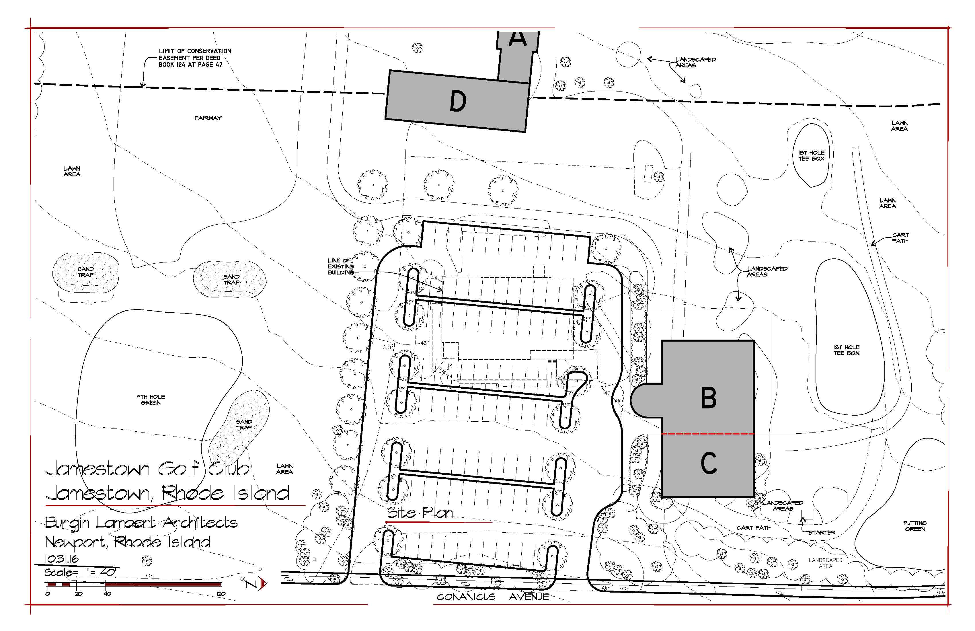

Slide 5
Jamestown Golf Course Clubhouse Facility
Proposed Building Program
GOLF SUPPORT ONLY
CADDY SHACK CONCESSION | 800
SALES/CHECK IN/OFFICE | 300
RESTROOMS | 300
CIRCULATION | 200
ANCELLARY/COOKING/STORAGE | 300
TOTAL GOLF FINISHED SPACE | 1900
BASEMENT - STORAGE/UTILITY SPACE | 1900
GOLF PORCHES/DECKS/TERRACE | 1800
GOLF CART STORAGE/EVENT SPACE (OPEN UNDER ROOF) | 2500
TOTAL GOLF SUPPORT | 6200
COMMUNITY/SHARED SPACE
MULTIPURPOSE ROOM | 1000
CATERING KITCHEN | 250
CIRCULATION | 250
ANCELLARY/STORAGE | 150
TOTAL COMMUNITY FINISHED SPACE | 1650
BASEMENT - STORAGE/UNPROGRAMMED SPACE | 1650
COMMUNITY PORCHES/DECKS/TERRACE | 1200
TOTAL COMMUNITY SPACE | 2850
TOTAL FINISHED SPACE | 3550
TOTAL PORCHES/DECKS/TERRACE | 3000
GOLF CART STORAGE/EVENT SPACE | 2500
TOTAL CLUBHOUSE AND COMMUNITY SPACE | 9050
INCLUDING GOLF CART STORAGE/EVENT SPACE)
(DOES NOT INCLUDE BASEMENT/STORAGE
UNPROGRAMMED SPACE)

Slide 8
Jamestown Golf Course Clubhouse Facility
Budget Considerations
Lease – currently $175,000/year
$145,000/year covers $2,000,000 in debt service

Slide 14
Jamestown Golf Course Clubhouse Facility
Construction Cost Summary – Farrar & Associates
Base Building First Floor – “Caddy Shack” + overflow/ community space Basement – For utilities and Storage, no walkout or public access Terraces/Patios - at grade on west and north sides | $ 1,910,725 (includes Contingency)
Alternate 1 – Gazebo ($47,914) and Chimney ($61,226) | $ 109,140
Alternate 2 – Cart Storage Structure | $ 225,556
Alternate 3 - Walk-Out Basement & Deck | $ 499,064
Alternate 4 – Second Floor | $ 772,912

Slide 15
Jamestown Golf Course Clubhouse Facility
Next Steps
Select Base Building + alternates
Set Budget
Warrant for Financial Town Meeting

